Slide 1
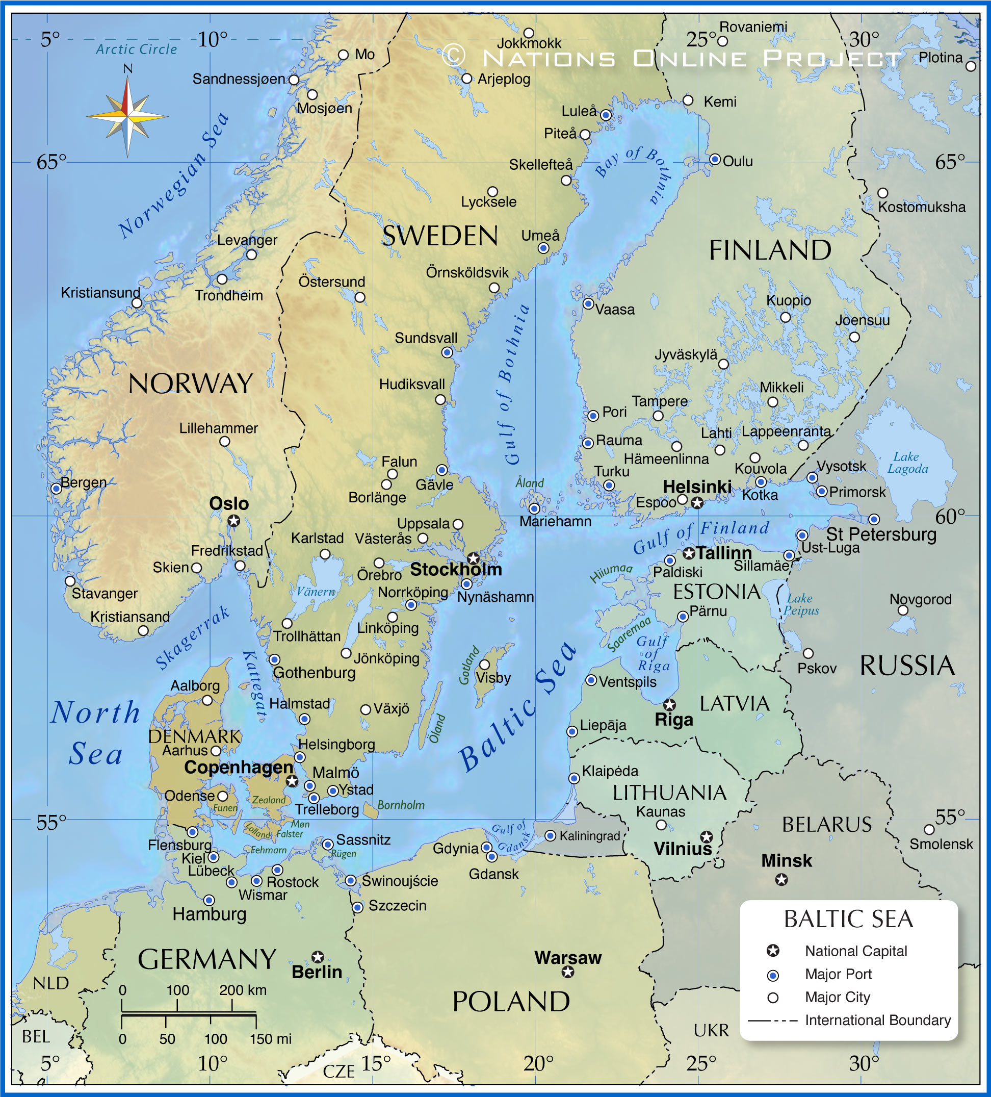




Aarhus Pilot
CityBlues meets LATESTadapt
Leave the logo of the project you represent

Slide 2
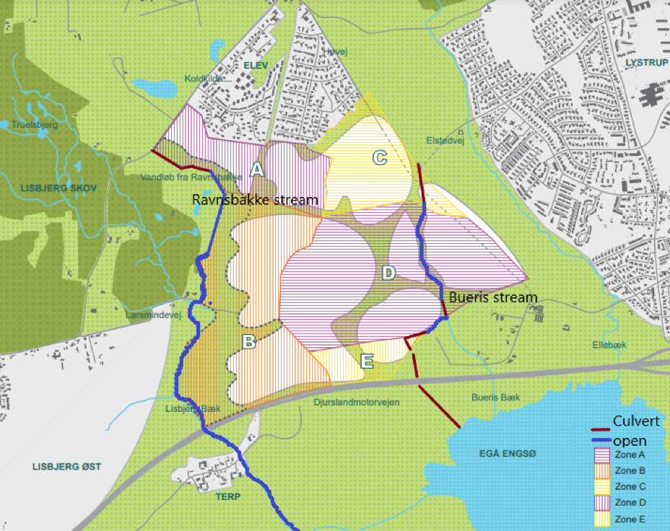
Nye – new residental area which will be a home for 17 000 citizens on 10 years time.
Ravnbakke- and Bueris streams (each with catchment area approx. 1,5–1,6 km²), that have to receive and carry the rainwater loads from the development area. The full masterplan covers about 150 hectares.
Hydraulic capacity problems in watercourses
Bank erosion during high flow conditions
Ecological targets in the River Basin Management Plan
Risk of drought (drying out) when the natural catchment is removed
Can the water balance be maintained when rainwater is reused in residential areas?
Removal of invasive species- Giant Hogweed
Reopening and restoration of Bueris stream, walking tracks along streams
Restoration and reopening of Ravnbakke stream, small ponds or amphibians, recreational blue-green connections between residental area and streams
Removing invasive species
Notes:
In total, 200 000 euros is reserved for construction of NBS by City Blues project and 12 000 euros comes from the city’s budget. The cost of planning hours comes from the salary of the municipal team and is funded by the city.
Reports, data collection and analyses, monitoring is funded through the City Blues project. It will confirm that the analyses, information collected, documented, and partnerships developed through City Blues have provided a sufficient foundation for investment and long-term action.

Slide 3
Main lessons learnt
We have learned that risk management analyse ensures that this pilot area is safe, reliable, and adaptable addressing uncertainties related to water quantity, quality, system performance, and social acceptance. Important to gather experts from relevant departments from the beginning as well as utility and main stakeholders.
Be aware of unexpected issues that can appear and prepare time for that. We have learned that the preliminary investigation and good baseline based on good data material for NBS solutions is very valuable.
Use stakeholder workshops (Water Utility, Municipality, developers, citizens). Map physical risks using hydrological modelling (e.g., rainfall-runoff simulations). Identify social and institutional risks through interviews and past project reviews. Prioritize risks with high impact on safety, function, or long-term viability (e.g., pond overflow, infiltration failure).

