Slide 1



Urban cooling from Copernicus tree cover density in Estonia
Online Workshop on Urban Green Space and Heat Island Monitoring
Kairi Vint (Estonian Environment Agency)
April 17, 2026

Slide 2
Overview:
Project background: Local Climate Regulation funded by the Eurostat
Motivation: urban heat island effect and trees create cooling effect in their surroundings
Data: 3 largest urban areas in Estonia, Land Surface Temperature (LST), Google Earth Engine Evapotranspiration and Copernicus Tree Cover Density (TCD)
Method: linear regression models
Results: Tallinn, Tartu, Narva
Challenges: TCD only year 2018 and for LST only years 2022 and 2024
Conclusions

Slide 3
Project background:
Project name: Development of Environmental Accounts
This project is funded by the Eurostat
Collaboration between Estonian Environment Agency, Tallinn University of Technology and Statistics Estonia
Local Climate Regulation defined as the way urban vegetation helps cool cities and improve living conditions. Measured as the cooling effect of urban vegetation on days hotter than 25 degrees Celsius.

Slide 4
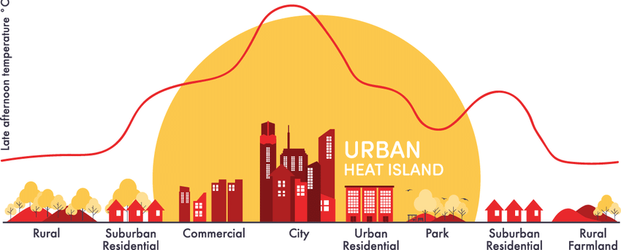
Motivation: urban heat island effect
Urban areas are significantly warmer than surrounding rural areas
Source: http://coolparramatta.com.au/about_us

Slide 5
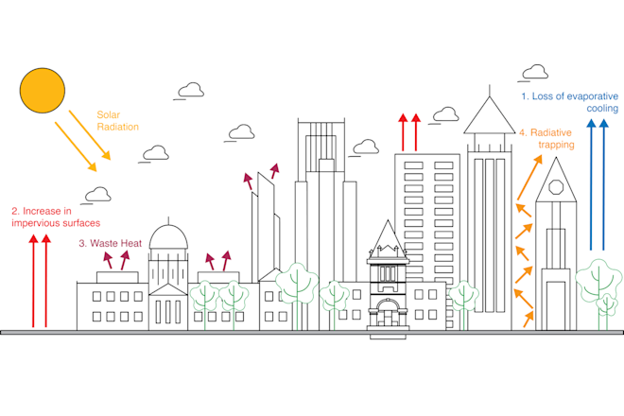
Motivation: Urban heat island effect
Contributing factors:
1. Loss of evaporative cooling
2. Increase in impervious surfaces.
3. Waste Heat
4. Radiative trapping
Brian Stone. Source: Dey et al. 2024, CC BY-ND

Slide 6
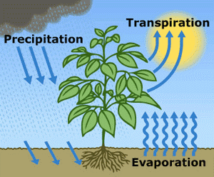
Motivation: evapotranspiration
Evapotranspiration product from Google Earth Engine
Through evapotranspiration trees and vegetation help cool the surrounding environment
Evapotranspiration is considered as sum of transpiration (Ec) and precipitation interception (Ei)
*Soil evaporation and evaporation from water bodies are not included in this analysis.
(Credit: U.S. Geological Survey)

Slide 7

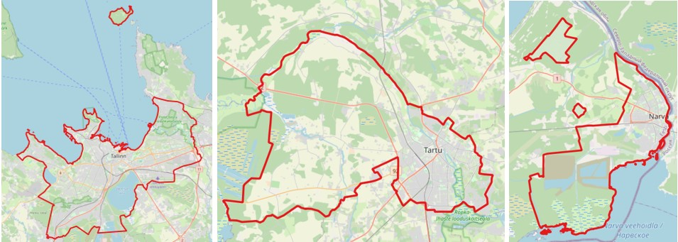
3 largest urban area in Estonia
Tallinn
Tartu
Narva

Slide 8
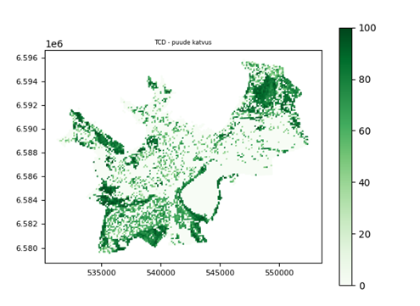
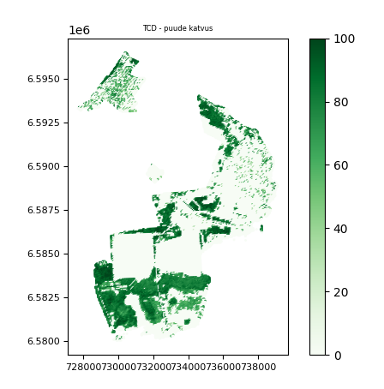
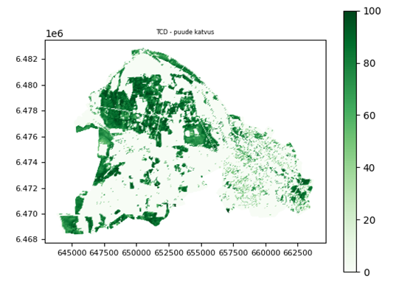
Tree Cover Density % (TCD)
Tree Cover Density product 2018, derived from the Copernicus High Resolution Layer, shows, which part of area is covered by trees, values 0 to 100 %
Tallinn TCD 0-100%
Tartu TCD 0-100%
Narva TCD 0-100%

Slide 9

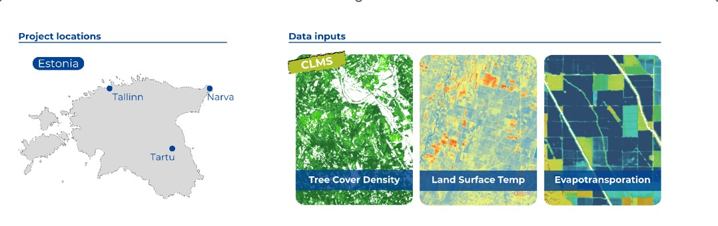
Datasets
3 largest Estonian cities: Tallinn, Tartu, Narva
Tree Cover Density (TCD) - Copernicus Land Monitoring Service (CLMS)
Land surface temperature (LST), Landsat 8/9
Evapotranspiration (Google Earth Engine)

Slide 10
Datasets for cooling effect calculation:
Tree Cover Density % (TCD) – data from Copernicus Land Monitoring Service (CLMS) (2018)
Land Surface Temperature (LST) – Landsat 8 and 9
Evapotranspiration (ET) – dataset from product „PML_V2 0.1.8: Coupled Evapotranspiration and Gross Primary Product (GPP)“ of Google Earth Engine Data Catalog (2022, 2023)
Ecosystems map – dataset from Statistics Estonia, which shows territorial distribution of different ecosystem types.
Maps of administrative units – datasets of municipality and settlement boundaries from the Estonian Land and Spatial Development Board

Slide 11
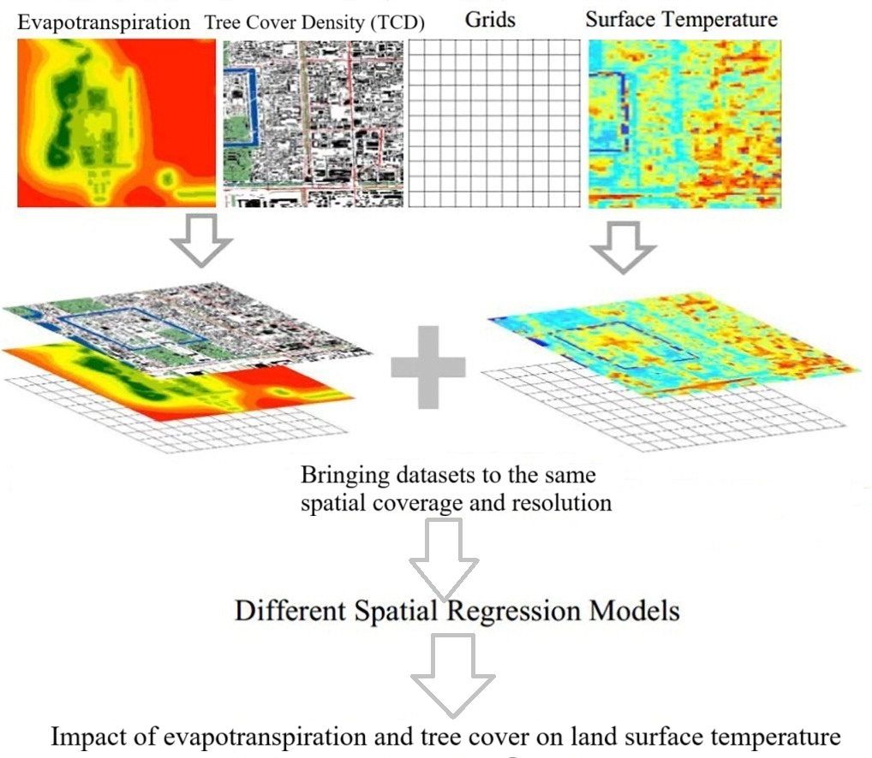
Method
It is crucial to bring all datasets to the same spatial coverage and resolution 30 meters
The calculations of vegetation cooling effect was calculated using linear regression models
The programs are designed to work in Linux environment
Python version 3.7.12 was used
Modified figure from: Zhaoxin Dai, Jean-Michel Guldmann, Yunfeng Hu. Spatial regression models of park and land-use impacts on the urban heat island in central Beijing, 2018.

Slide 12
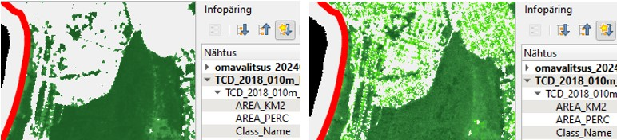
Challenges
TCD from newly downloaded 2018-year dataset (left) and earlier downloaded data year 2018 (right)
Newly downloaded datasets do not represent sparse tree cover in residential area. Dataset of year 2021 has the same peculiarity
In context of the present survey, the vegetation located in residential areas is very important, so its neglection in unacceptable. Due to that older dataset of year 2018 was selected for the calculations

Slide 13
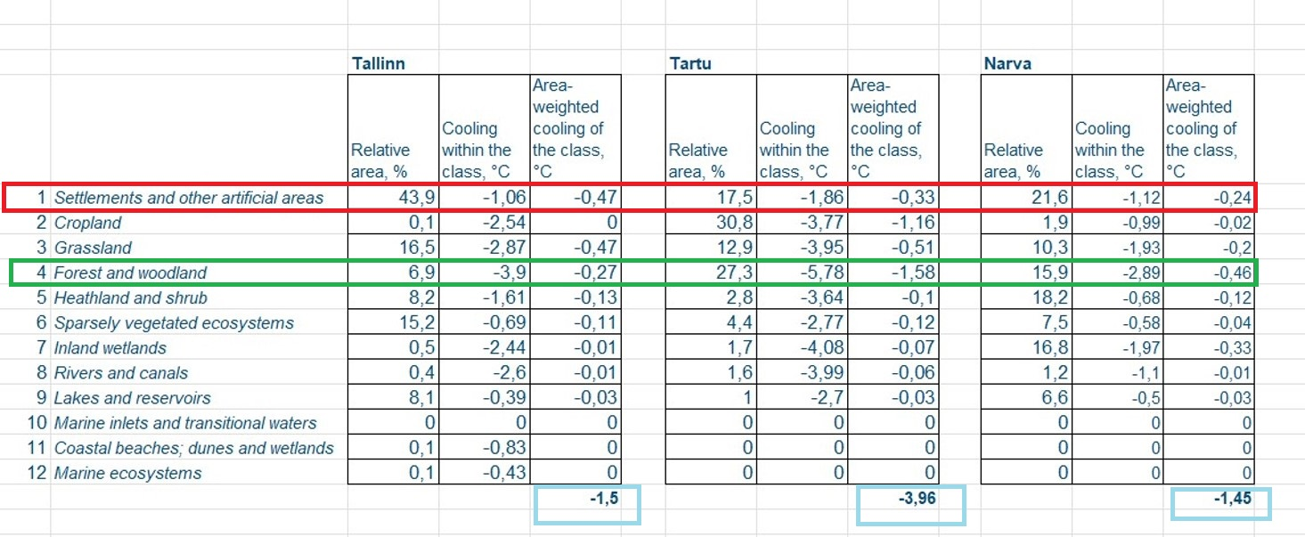
Results

Slide 14
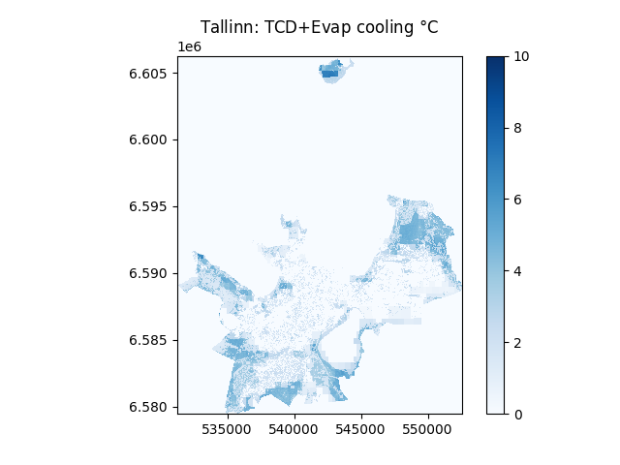
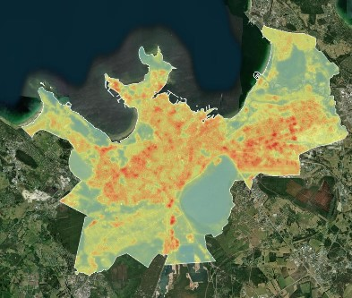
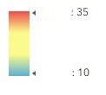
Results: Tallinn
TDC + Evapotranspiration cooling
Copernicus Tree Cover Density (TCD) 0-100%
Land Surface Temperature (LST)

Slide 15
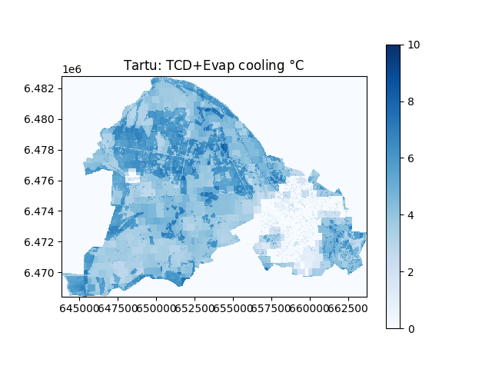
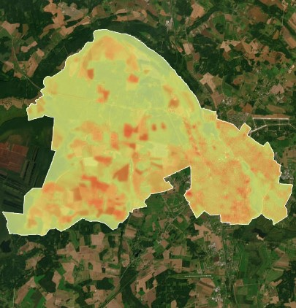
Results: Tartu
Copernicus Tree Cover Density (TCD) 0-100%
TDC + Evapotranspiration cooling
Land Surface Temperature (LST)

Slide 16
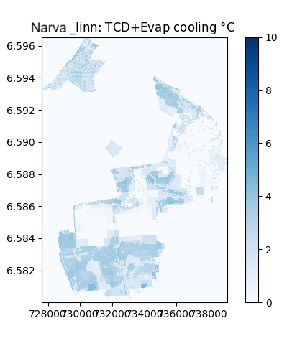
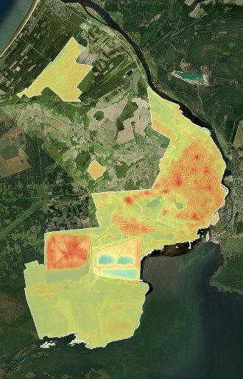
Results: Narva
TDC + Evapotranspiration cooling
Copernicus Tree Cover Density (TCD) 0-100%
Land Surface Temperature (LST)

Slide 17
Conclusions
Areas with higher vegetation cover show increased evapotranspiration, resulting in lower land surface temperatures during extreme heatwaves.
Copernicus tree cover data provided valuable insights for our project, though we found some challenges with resolution and update frequency. Overall, it’s a powerful tool for environmental monitoring and for urban climate regulation Ecosystem Service.
To better understand local climate regulation, more complex studies will be needed in the future (including coastal effects and other environmental factors).
This study would be preliminary work for future cities in Estonia, to support city planners and decision-makers to build up innovative heat resilient cities.

Slide 18
Thank you!
Technical Team:
Aleksei Vaštšenko, Ahto Mets,
Jekaterina Služenikina, Sander Ahi
Project Manager: Krisela Uussaar (Krisela.Uussaar@envir.ee)
Estonian Environment Agency

