Slide 1
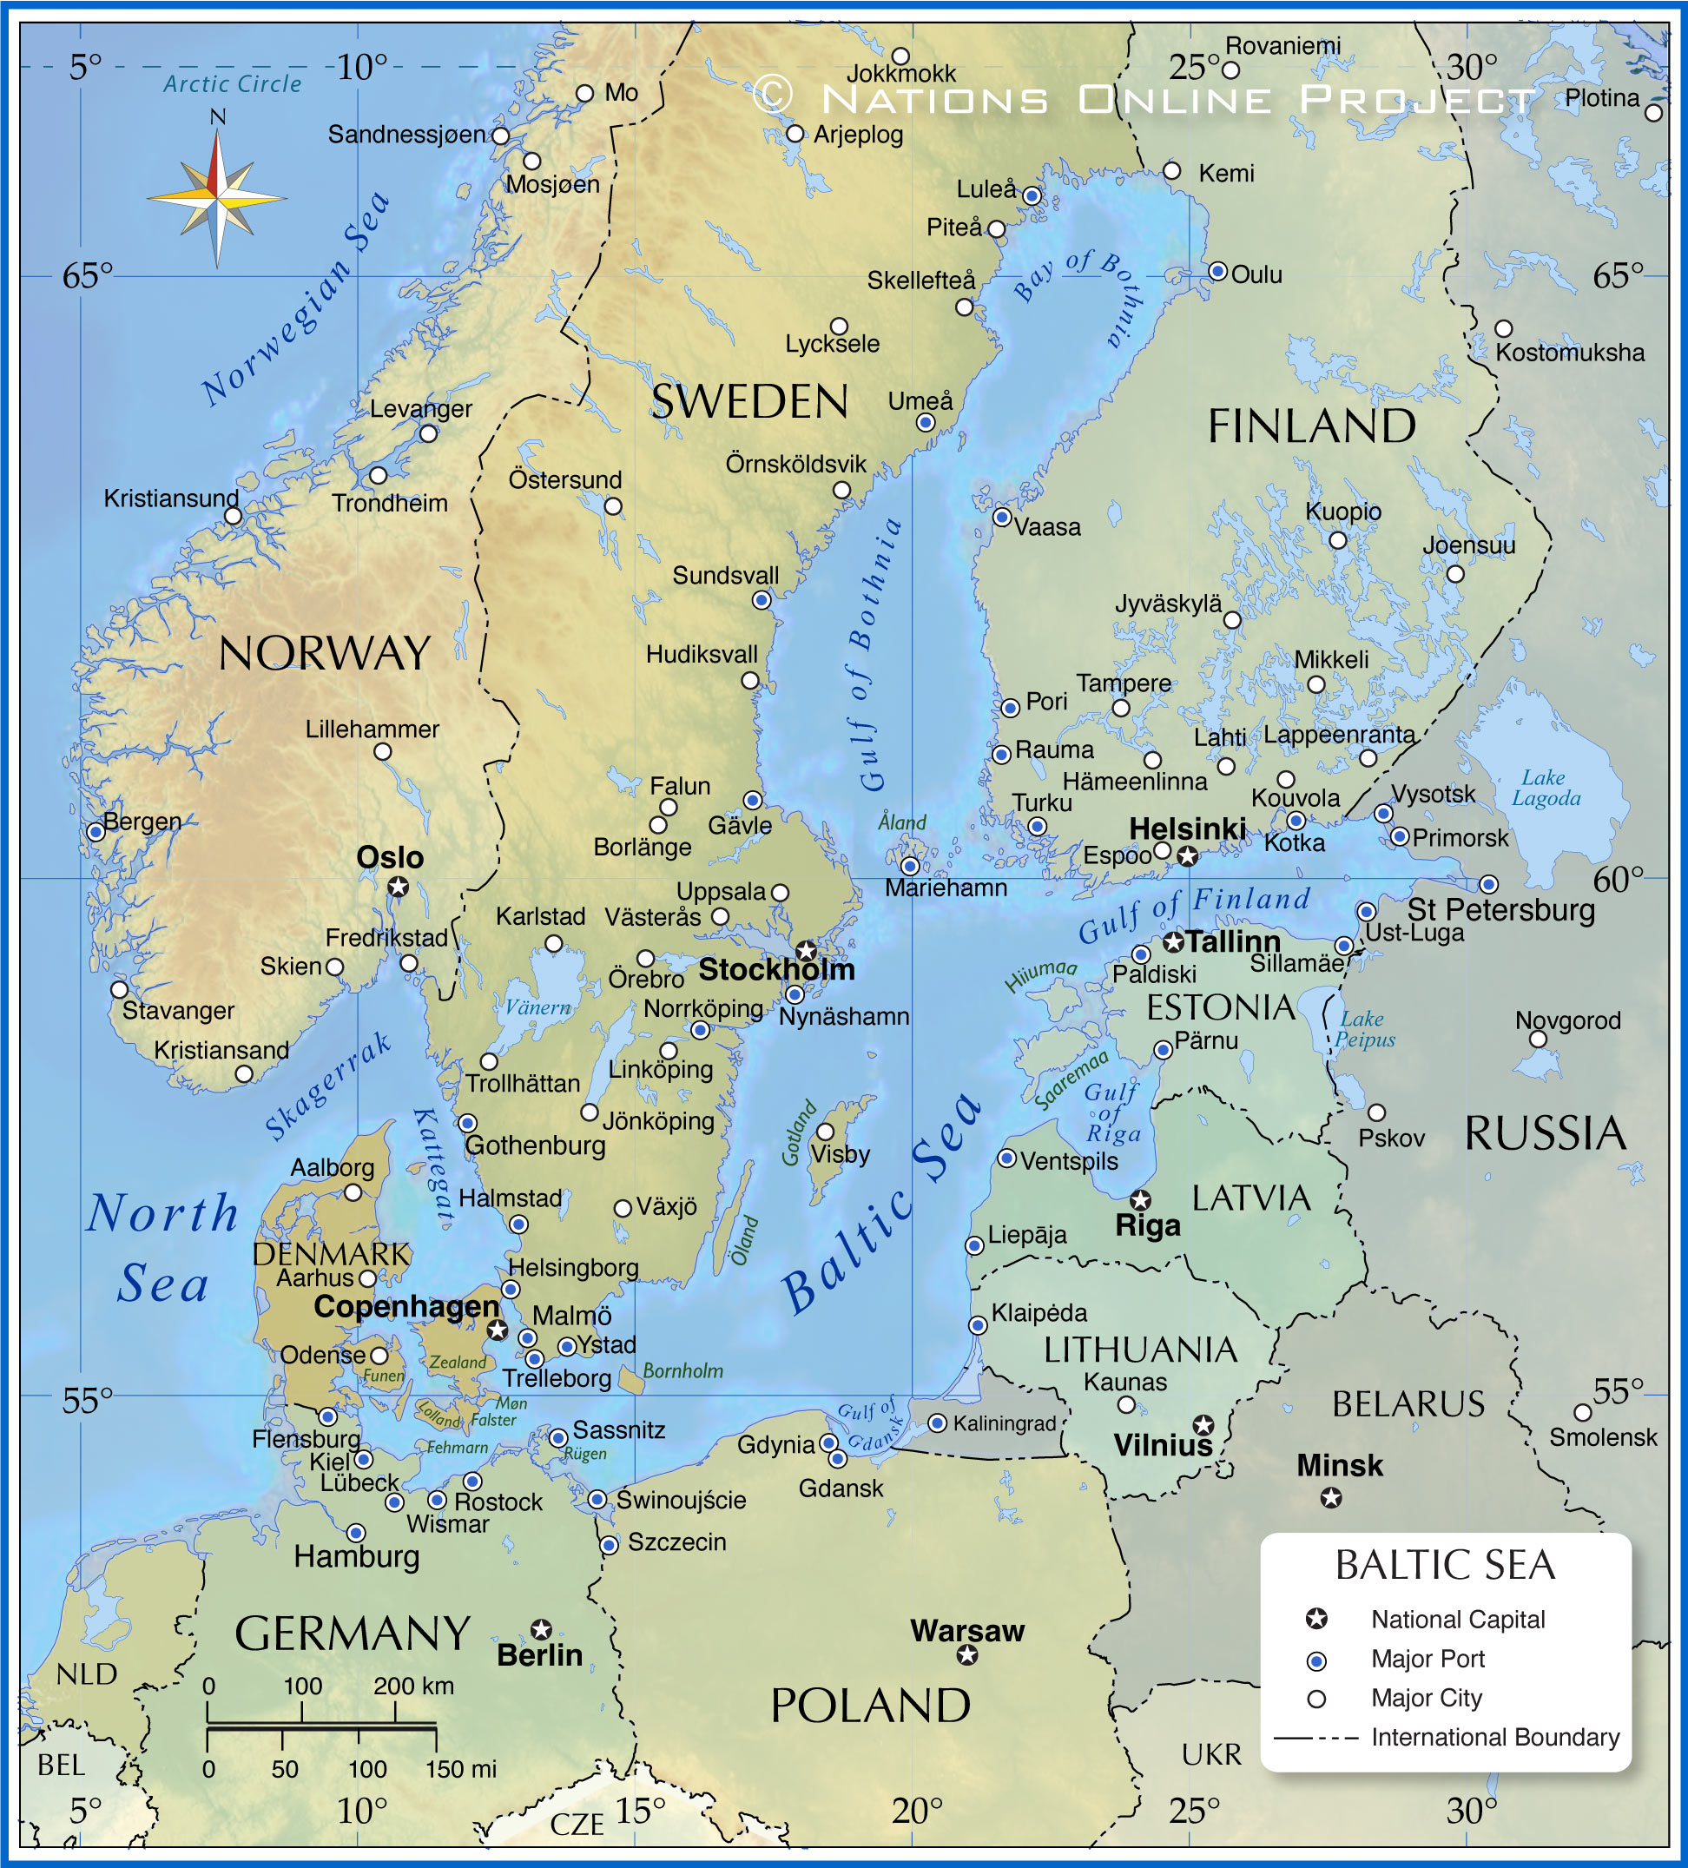


Haapsalu
CityBlues meets LATESTadapt

Slide 2
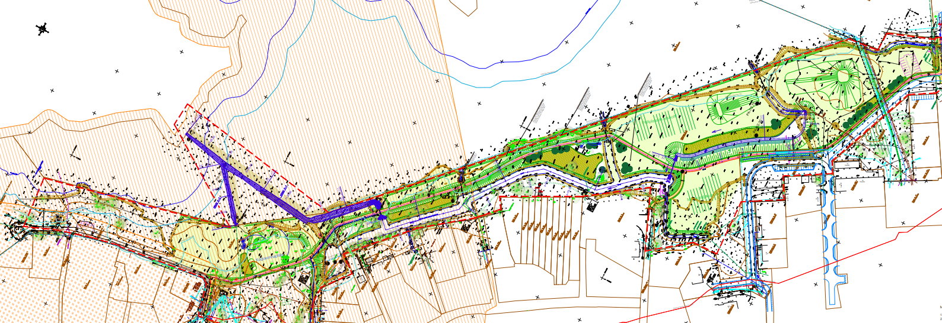
Size 7,4 (ha)
Investments budget 445.644.€
Designed 07.2024- 04.2025
Constructed 07.-12.2025

Slide 3
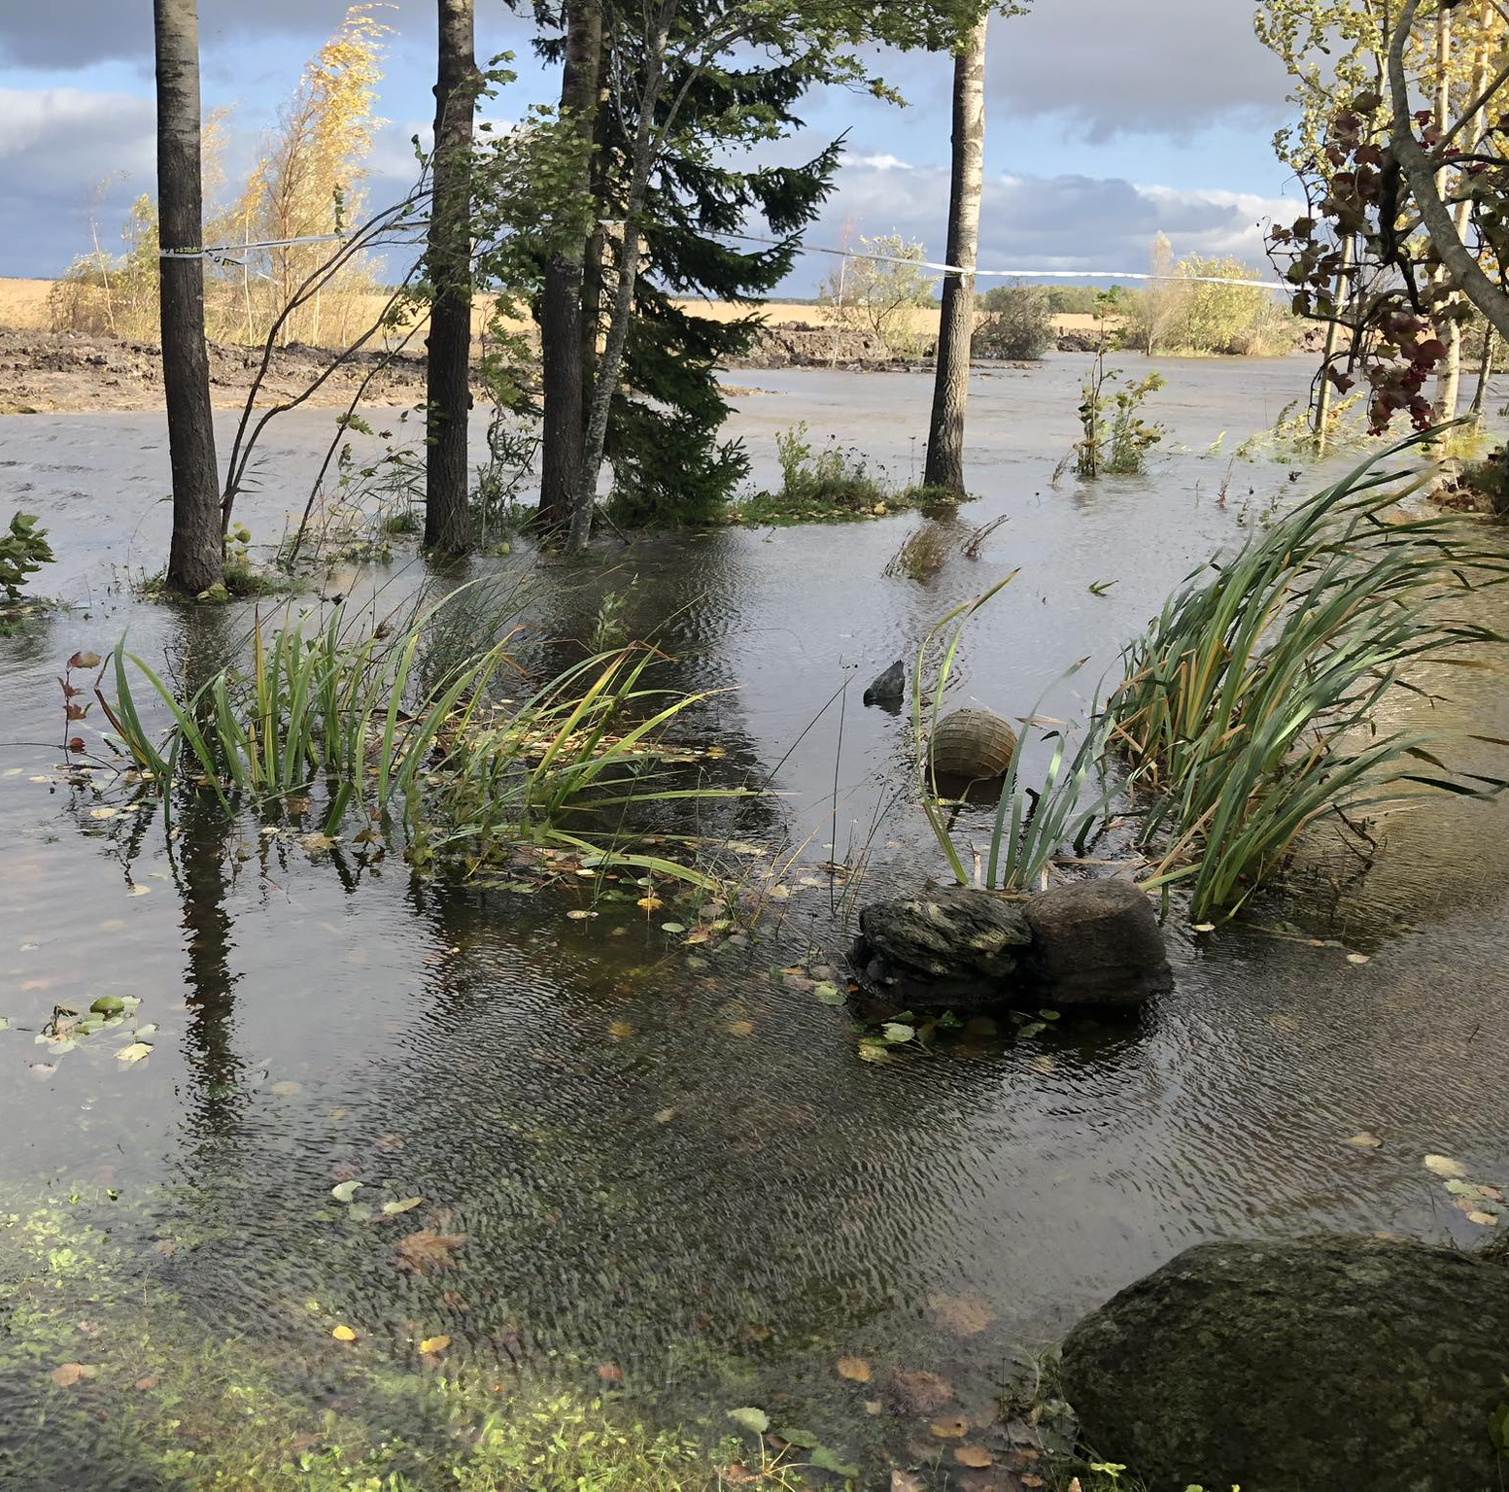
Objective of the pilot
reduce flooding in residential areas caused by stormwater;
ensure natural treatment of stormwater before it reaches the sea;
replace wasteland with a multifunctional, value-creating area.

Slide 4
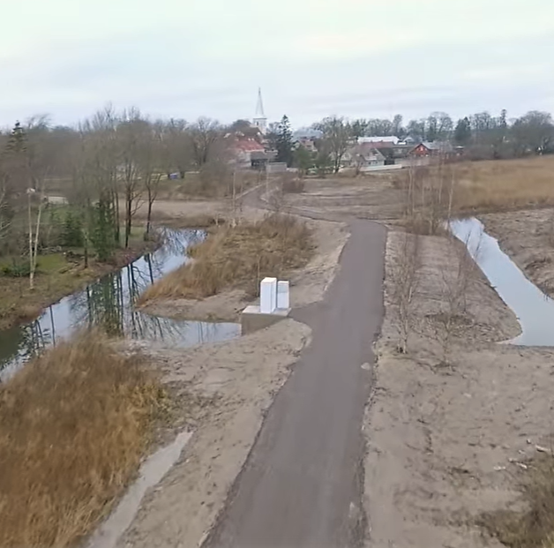
Constructed
a regulator to mitigate the impact of sea level rise,
shore protection embankment,
community area.

Slide 5
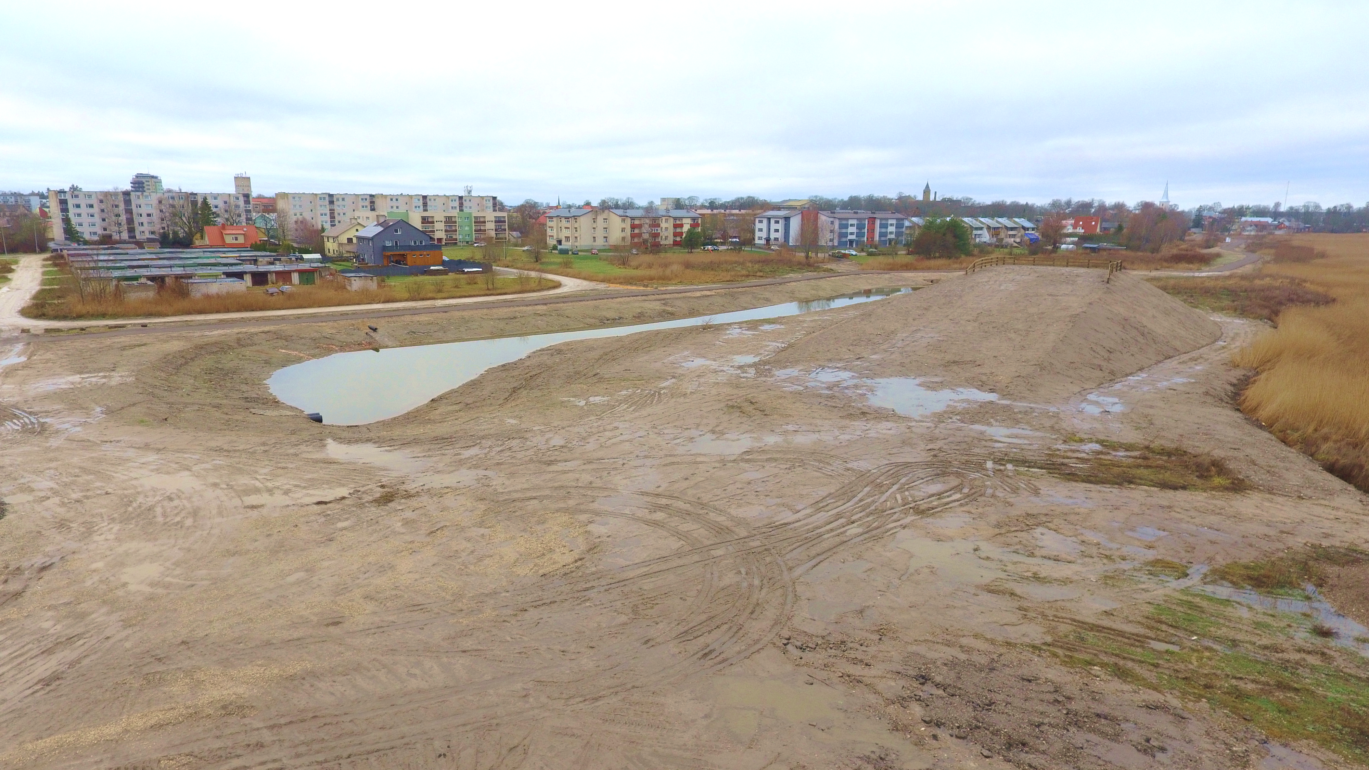
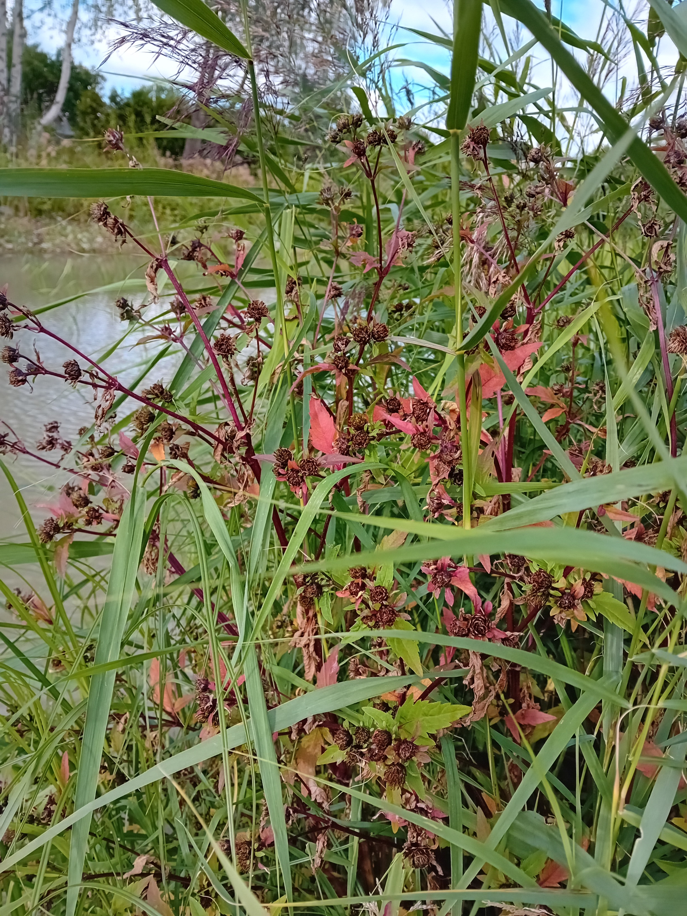
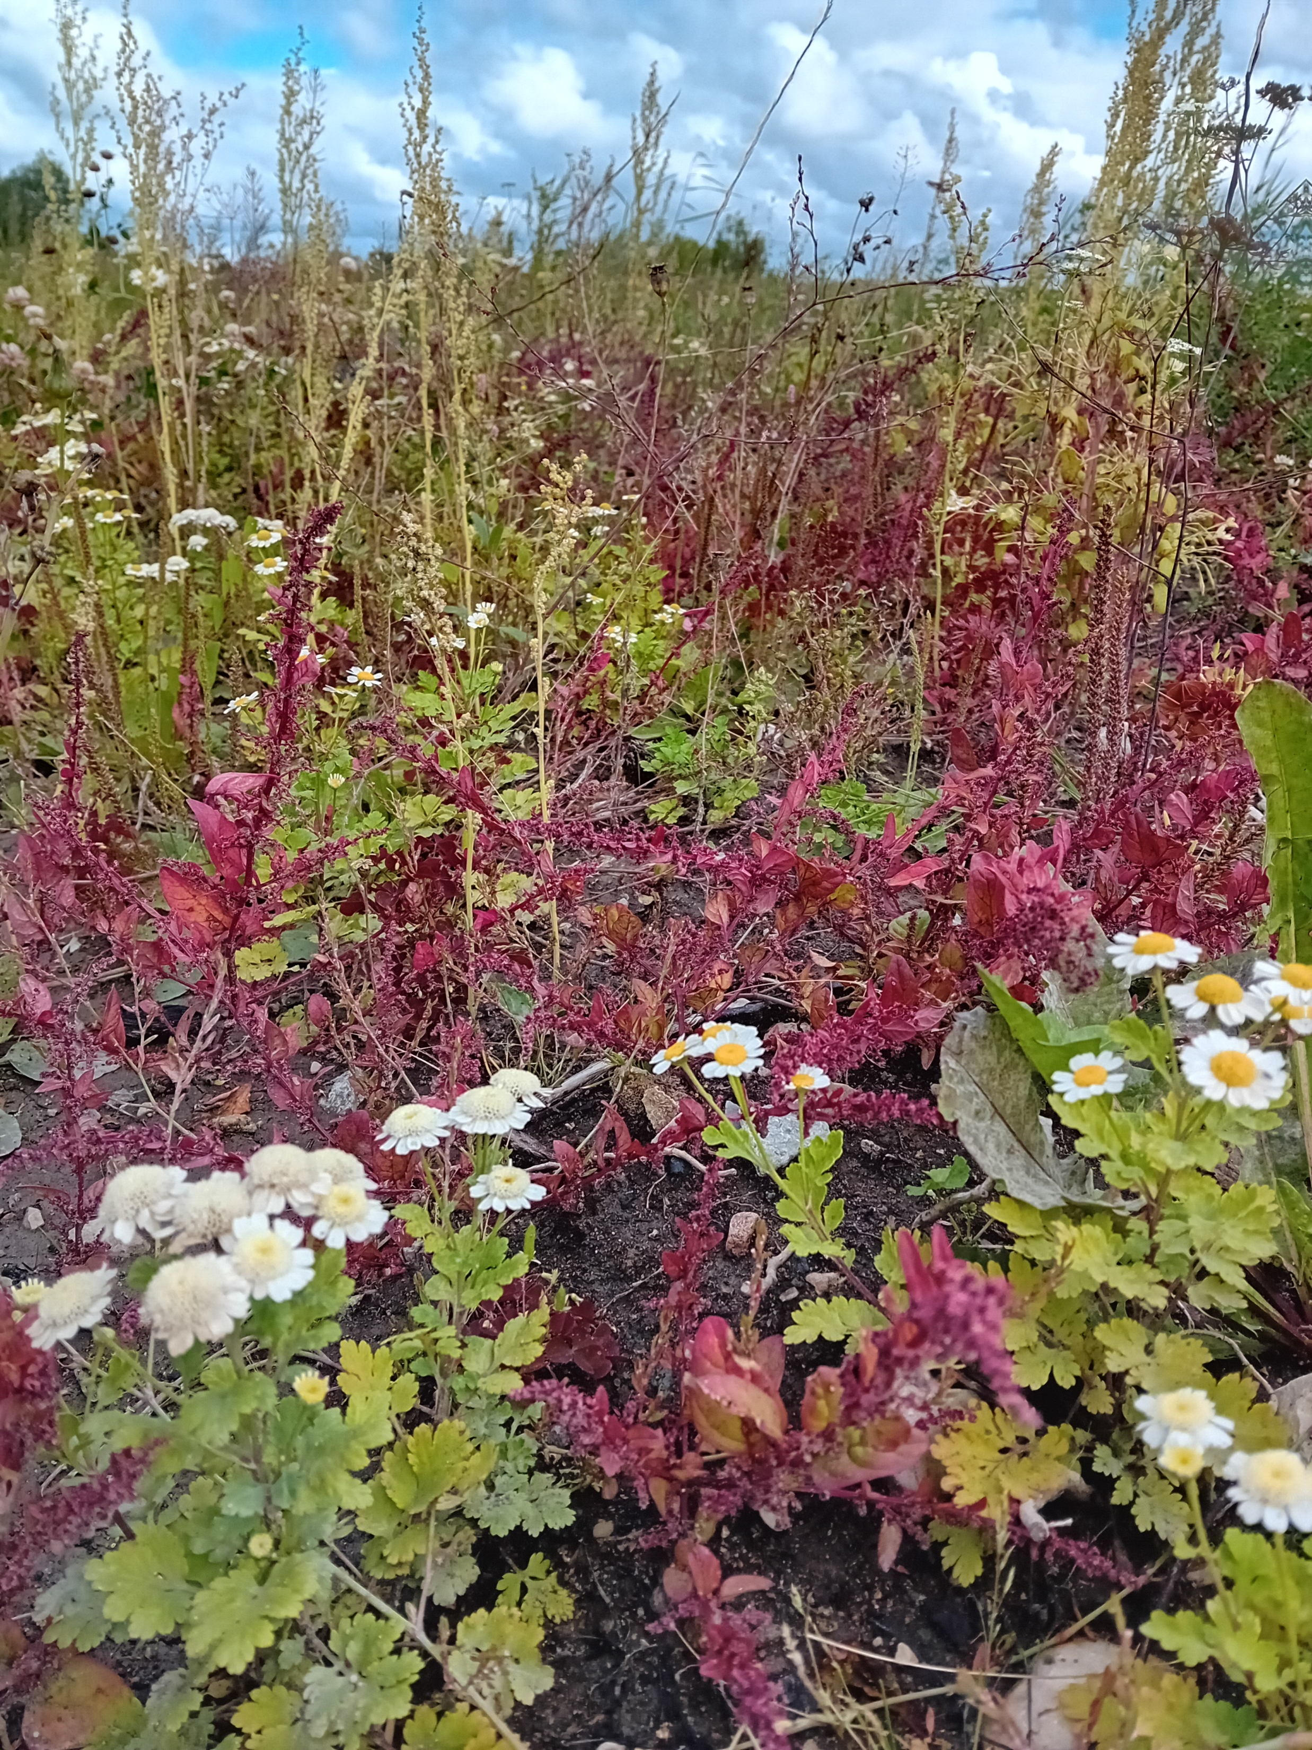
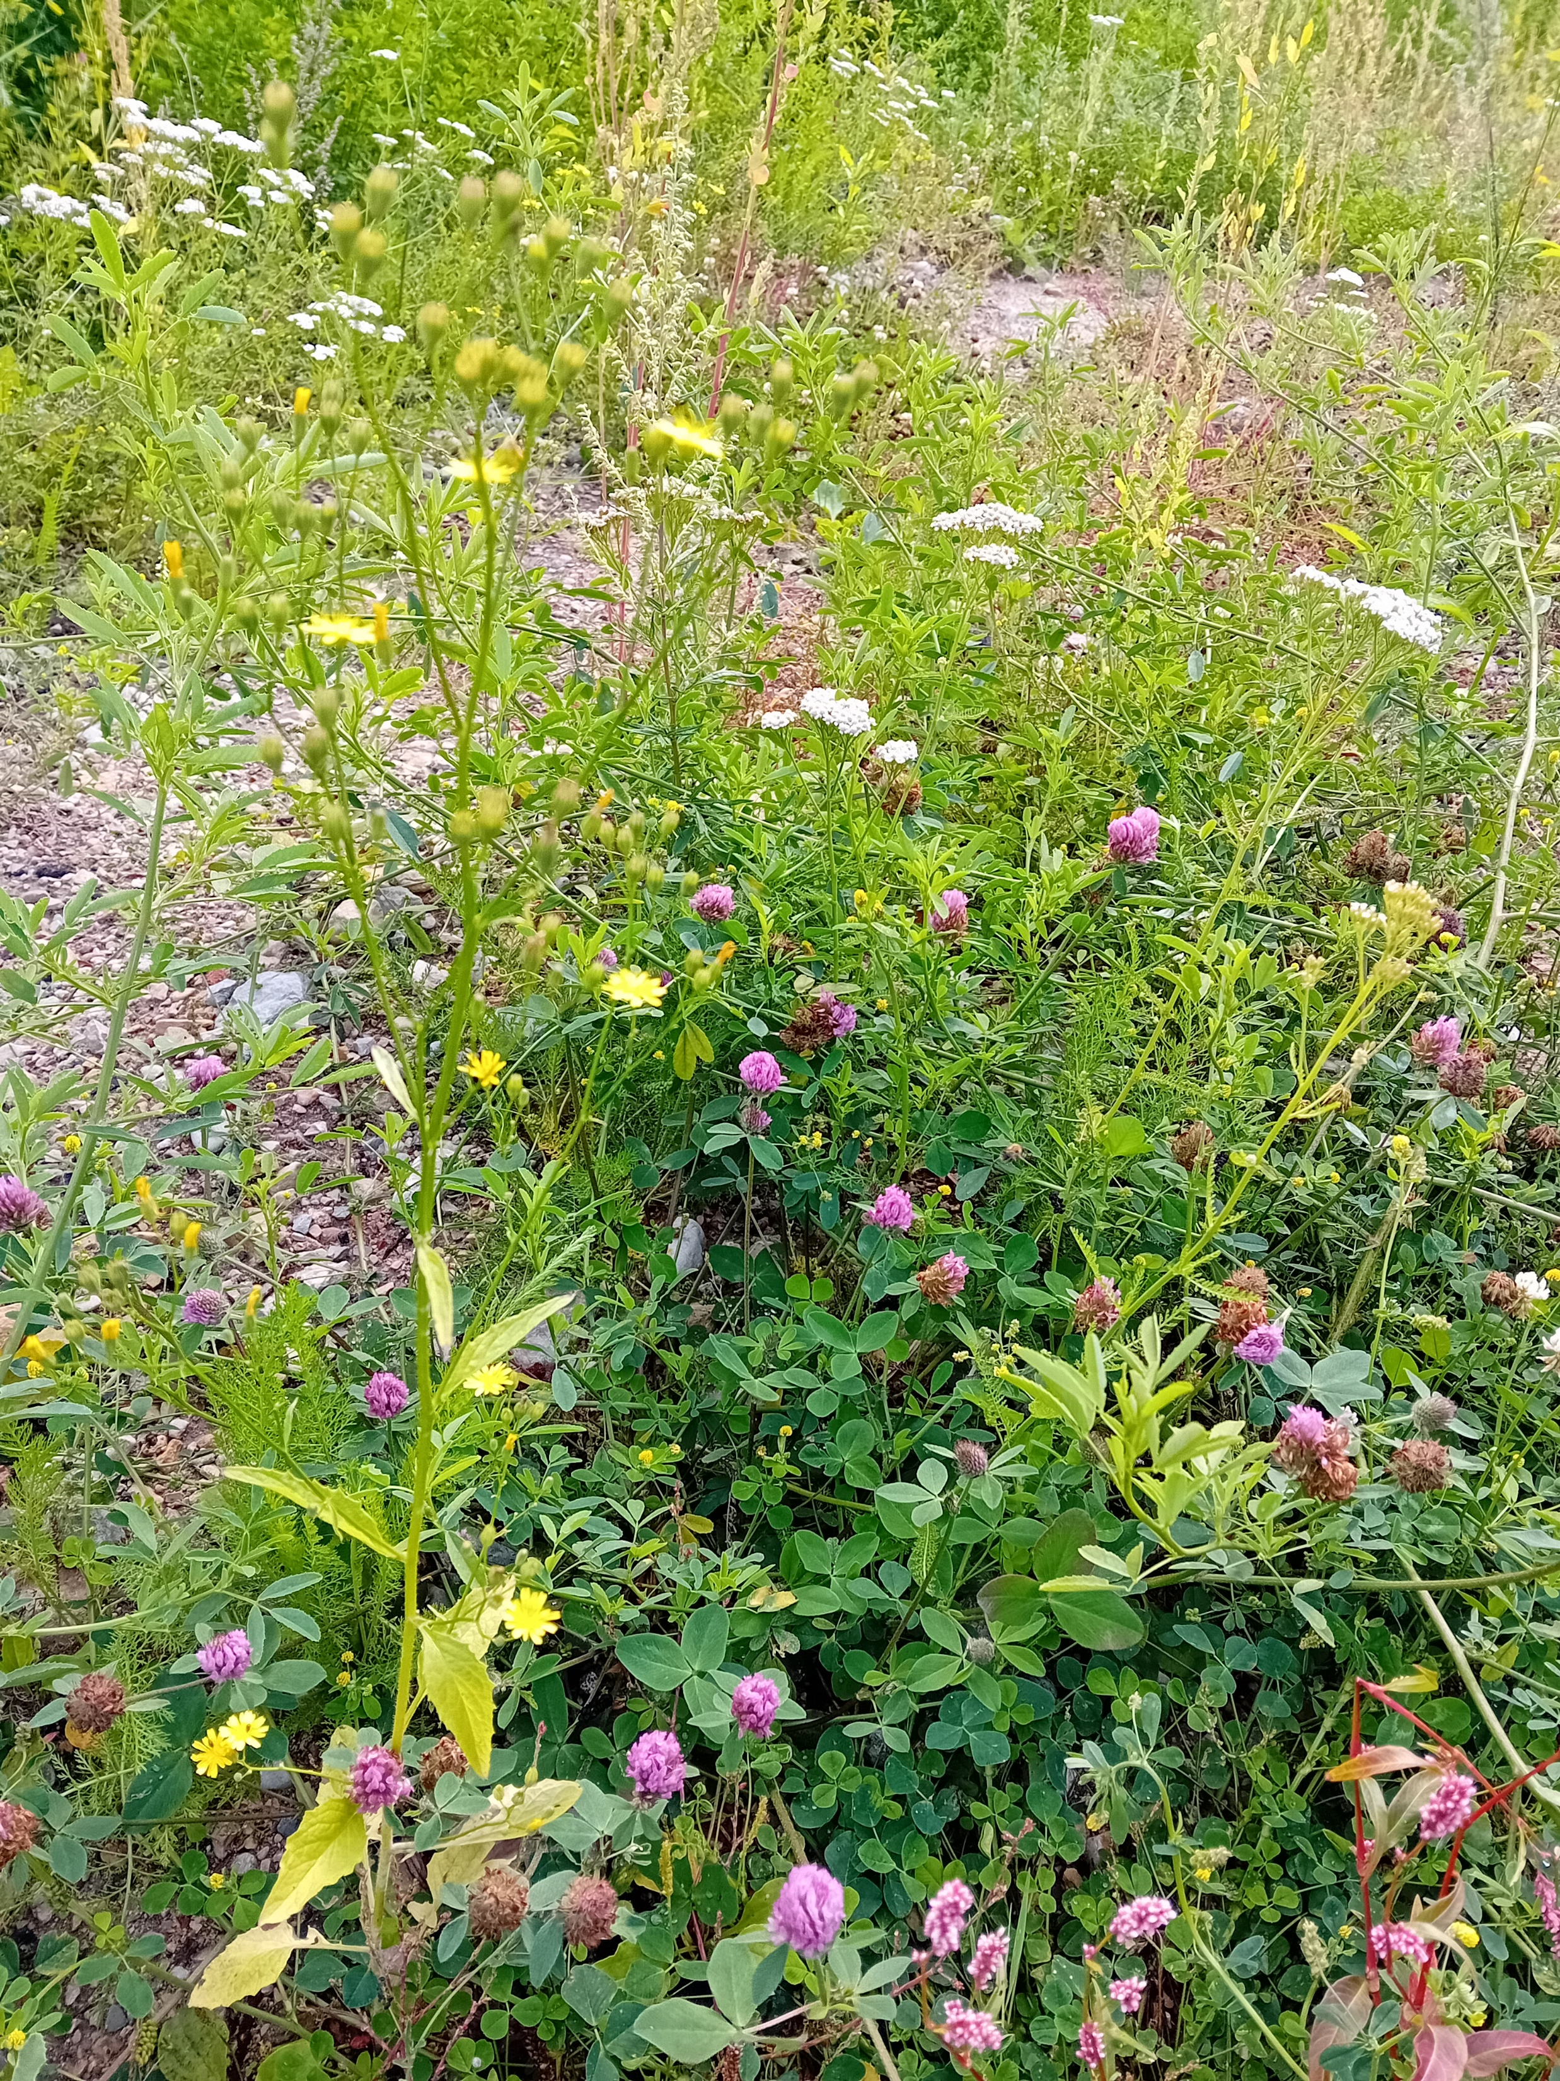
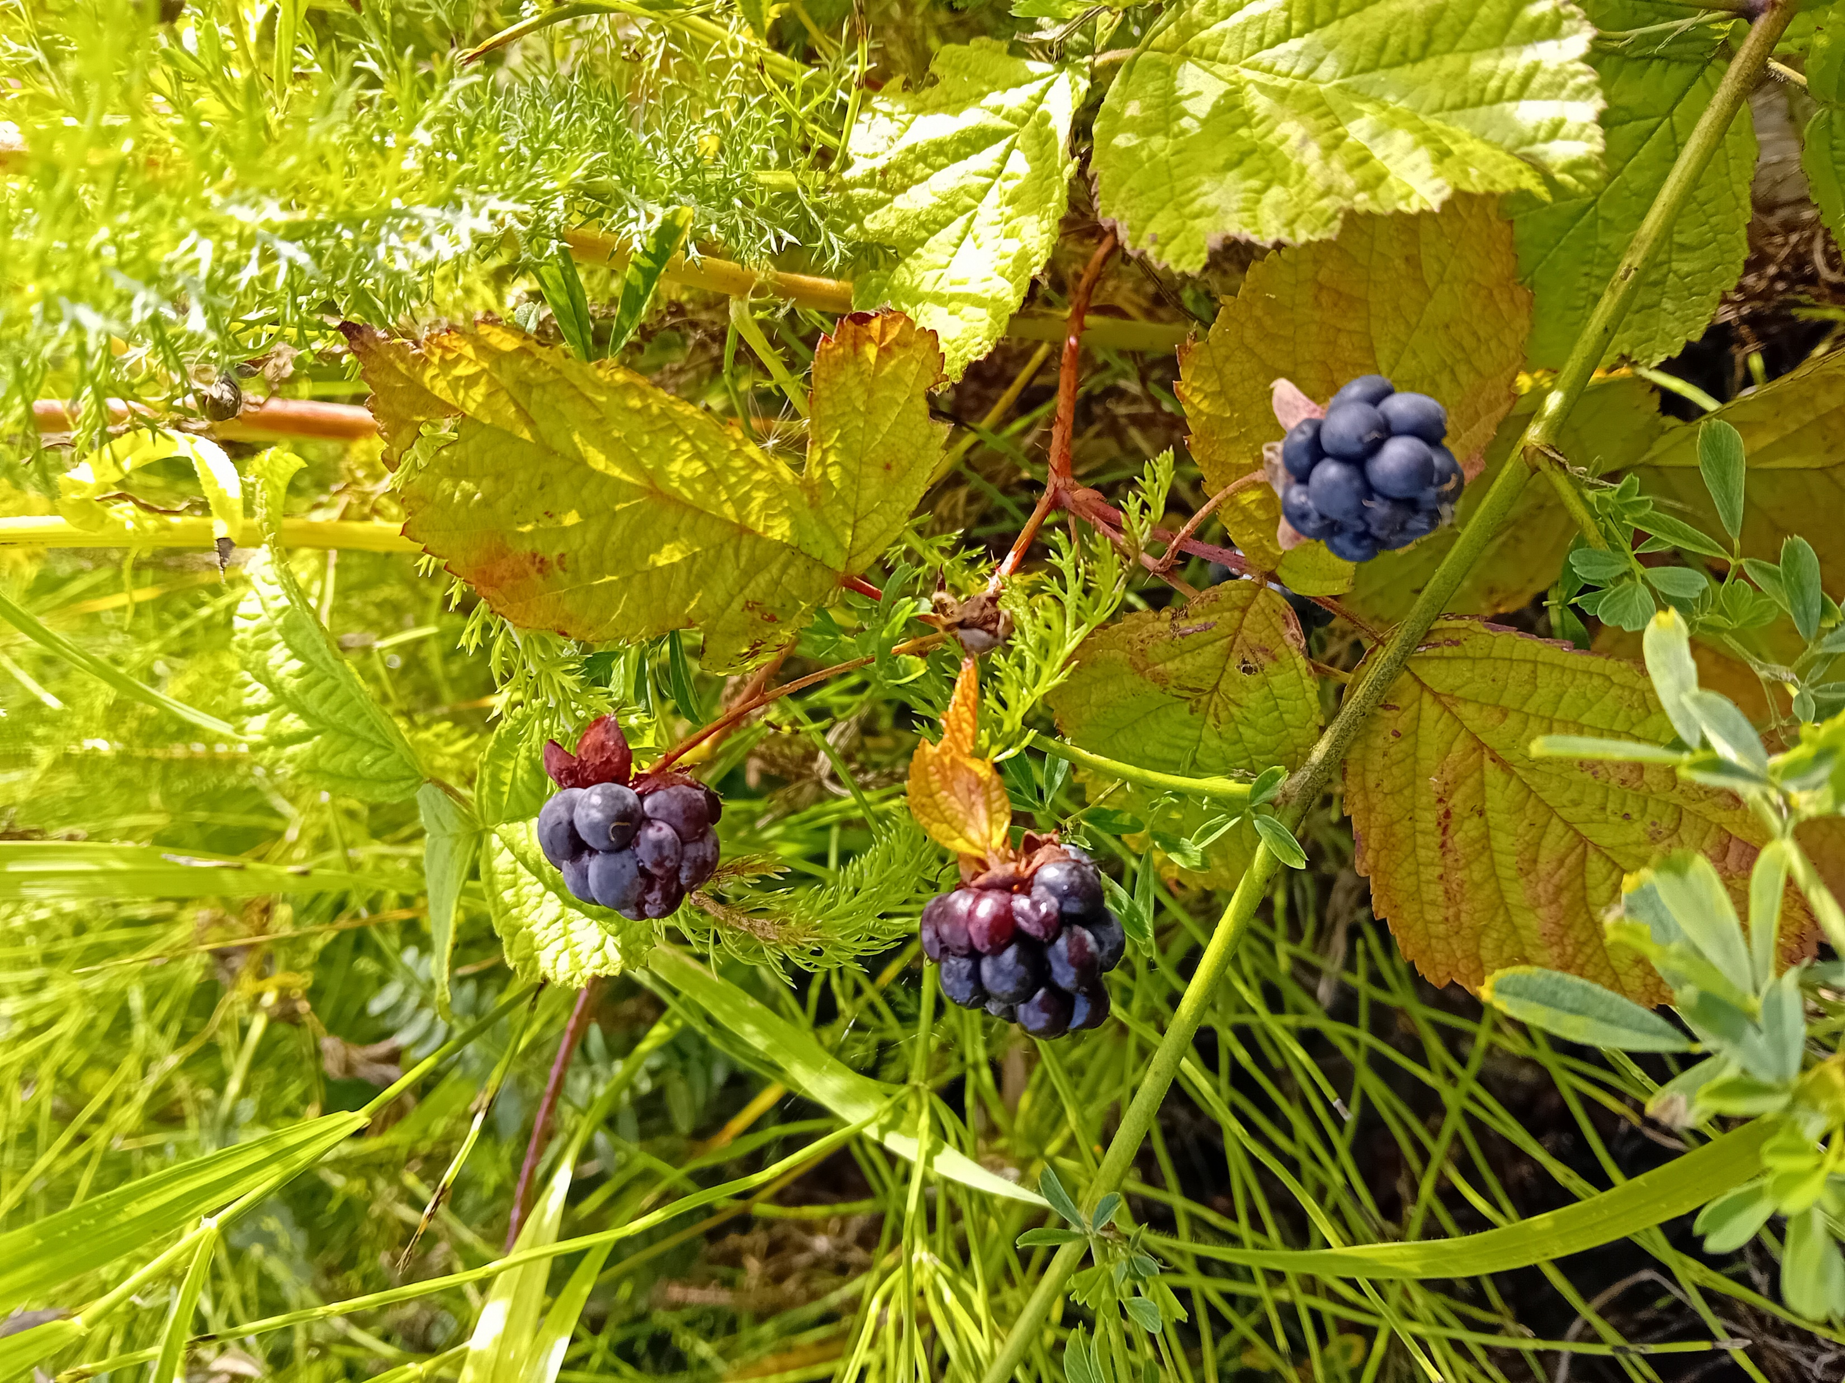
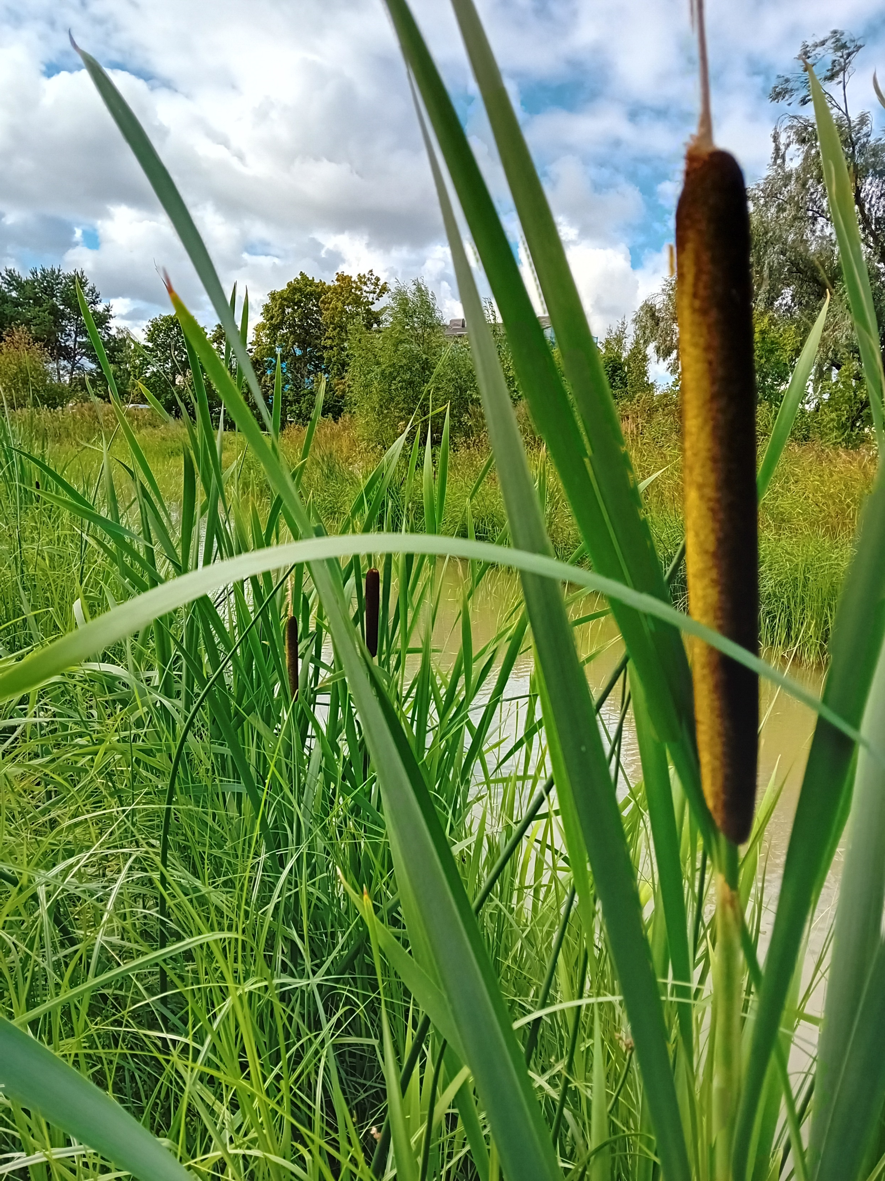
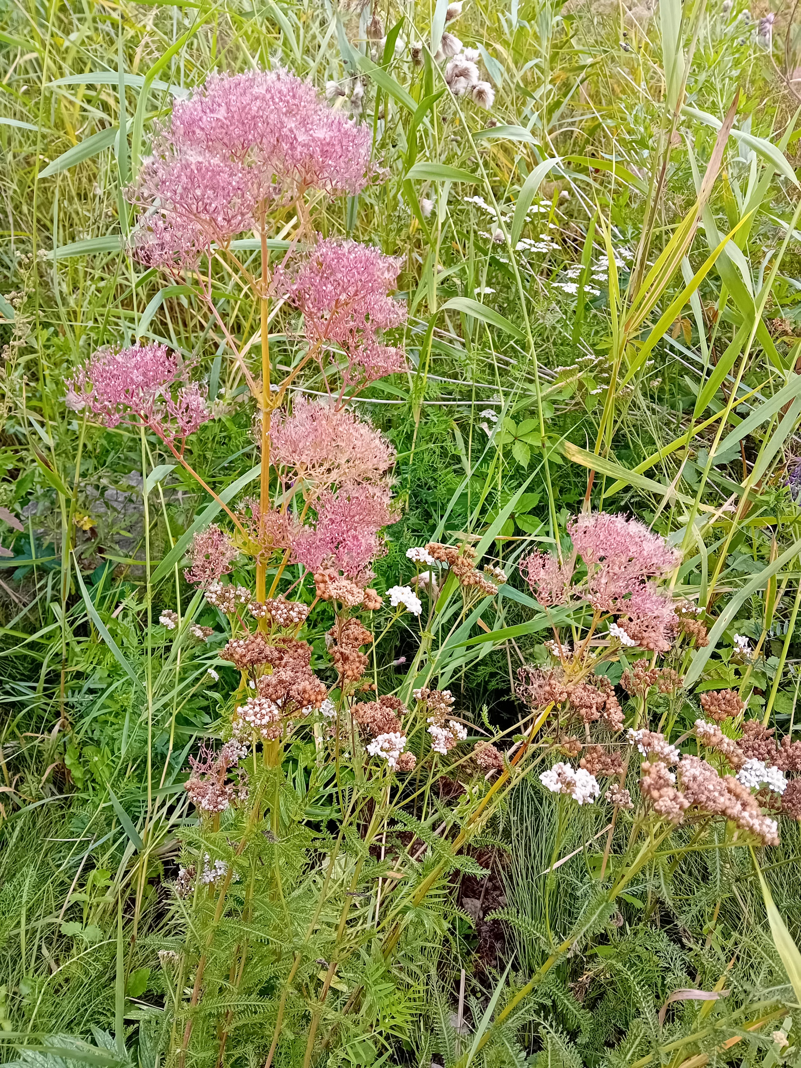
Constructed
wet swale for natural treatment of stormwater, before it reaches the sea;
sledge hill.

Slide 6
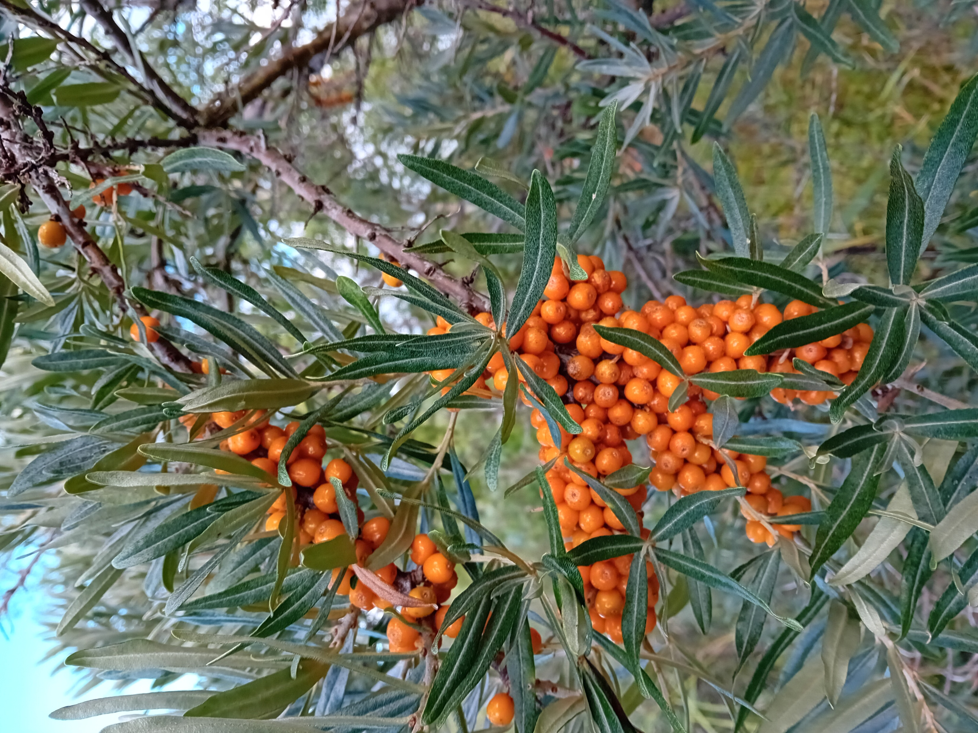
Main lessons learnt
Could not expect:
The team dispandment,
VAT increase – twice,
Designer procurement – thrice,
An earlier construction deadline set by the Ministry of Climate (later reversed).
Would do differently if we would start over:
Set less ambitious goals (perhaps…),
Involve a larger team;
Still don’t know, but would like to ask from other cities with experiences in NBS implementation:
how to plan well for unforeseen circumstances and a sustainable budget for a long project?

Slide 7
Haapsalu
CityBlues meets LATESTadapt
Gerda Ladva
Project Manager

