Slide 1
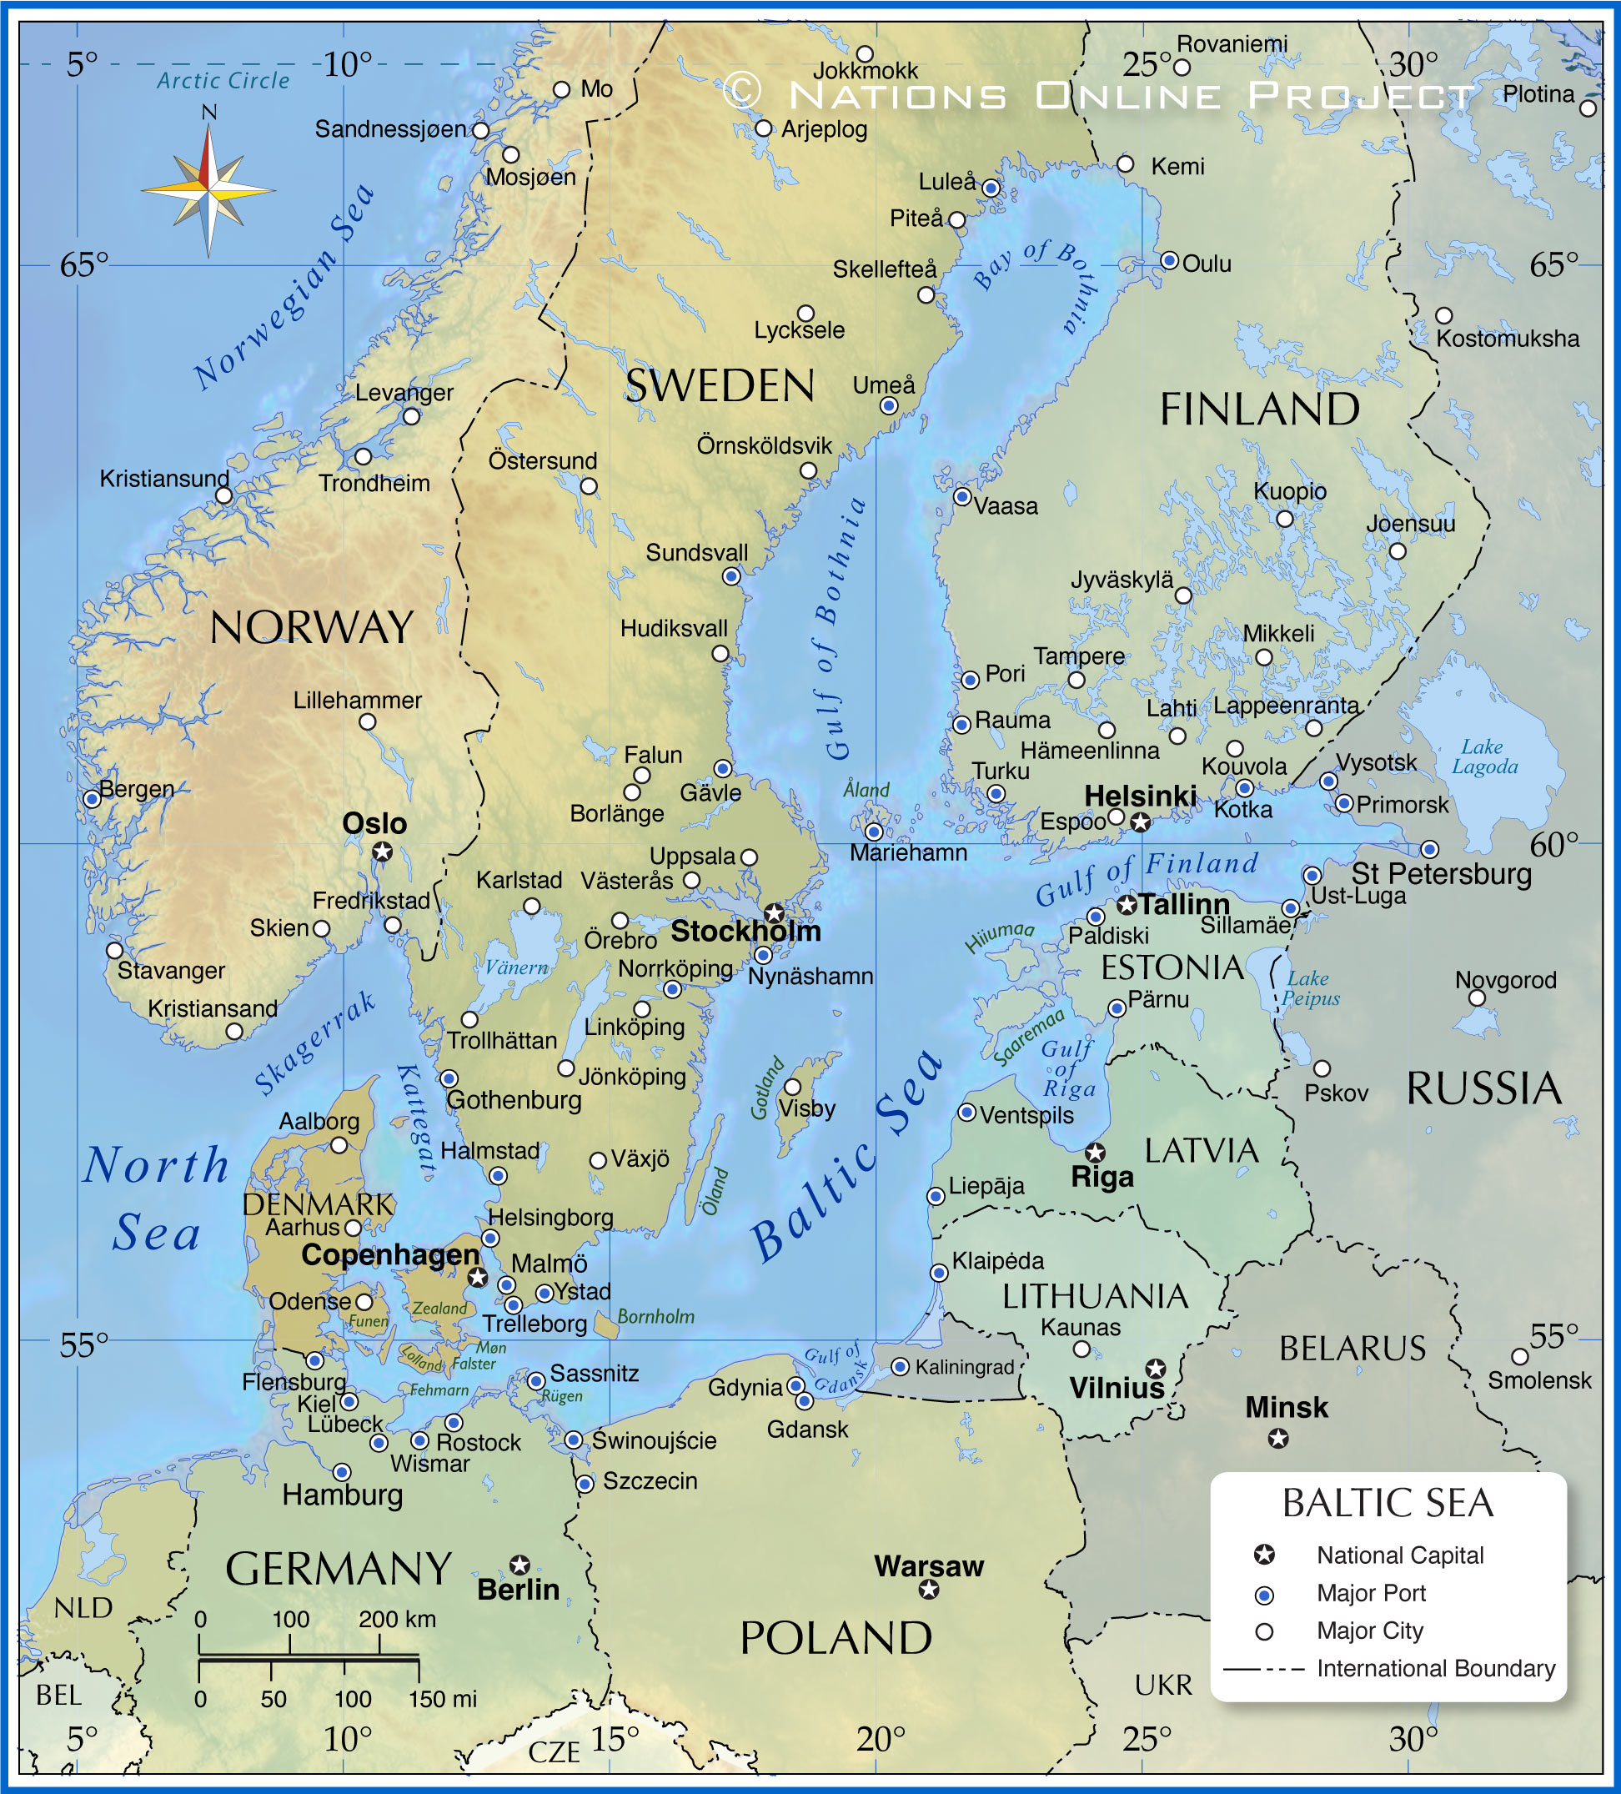




Risebergastream
-Malmö pilot
CityBlues meets LATESTadapt

Slide 2
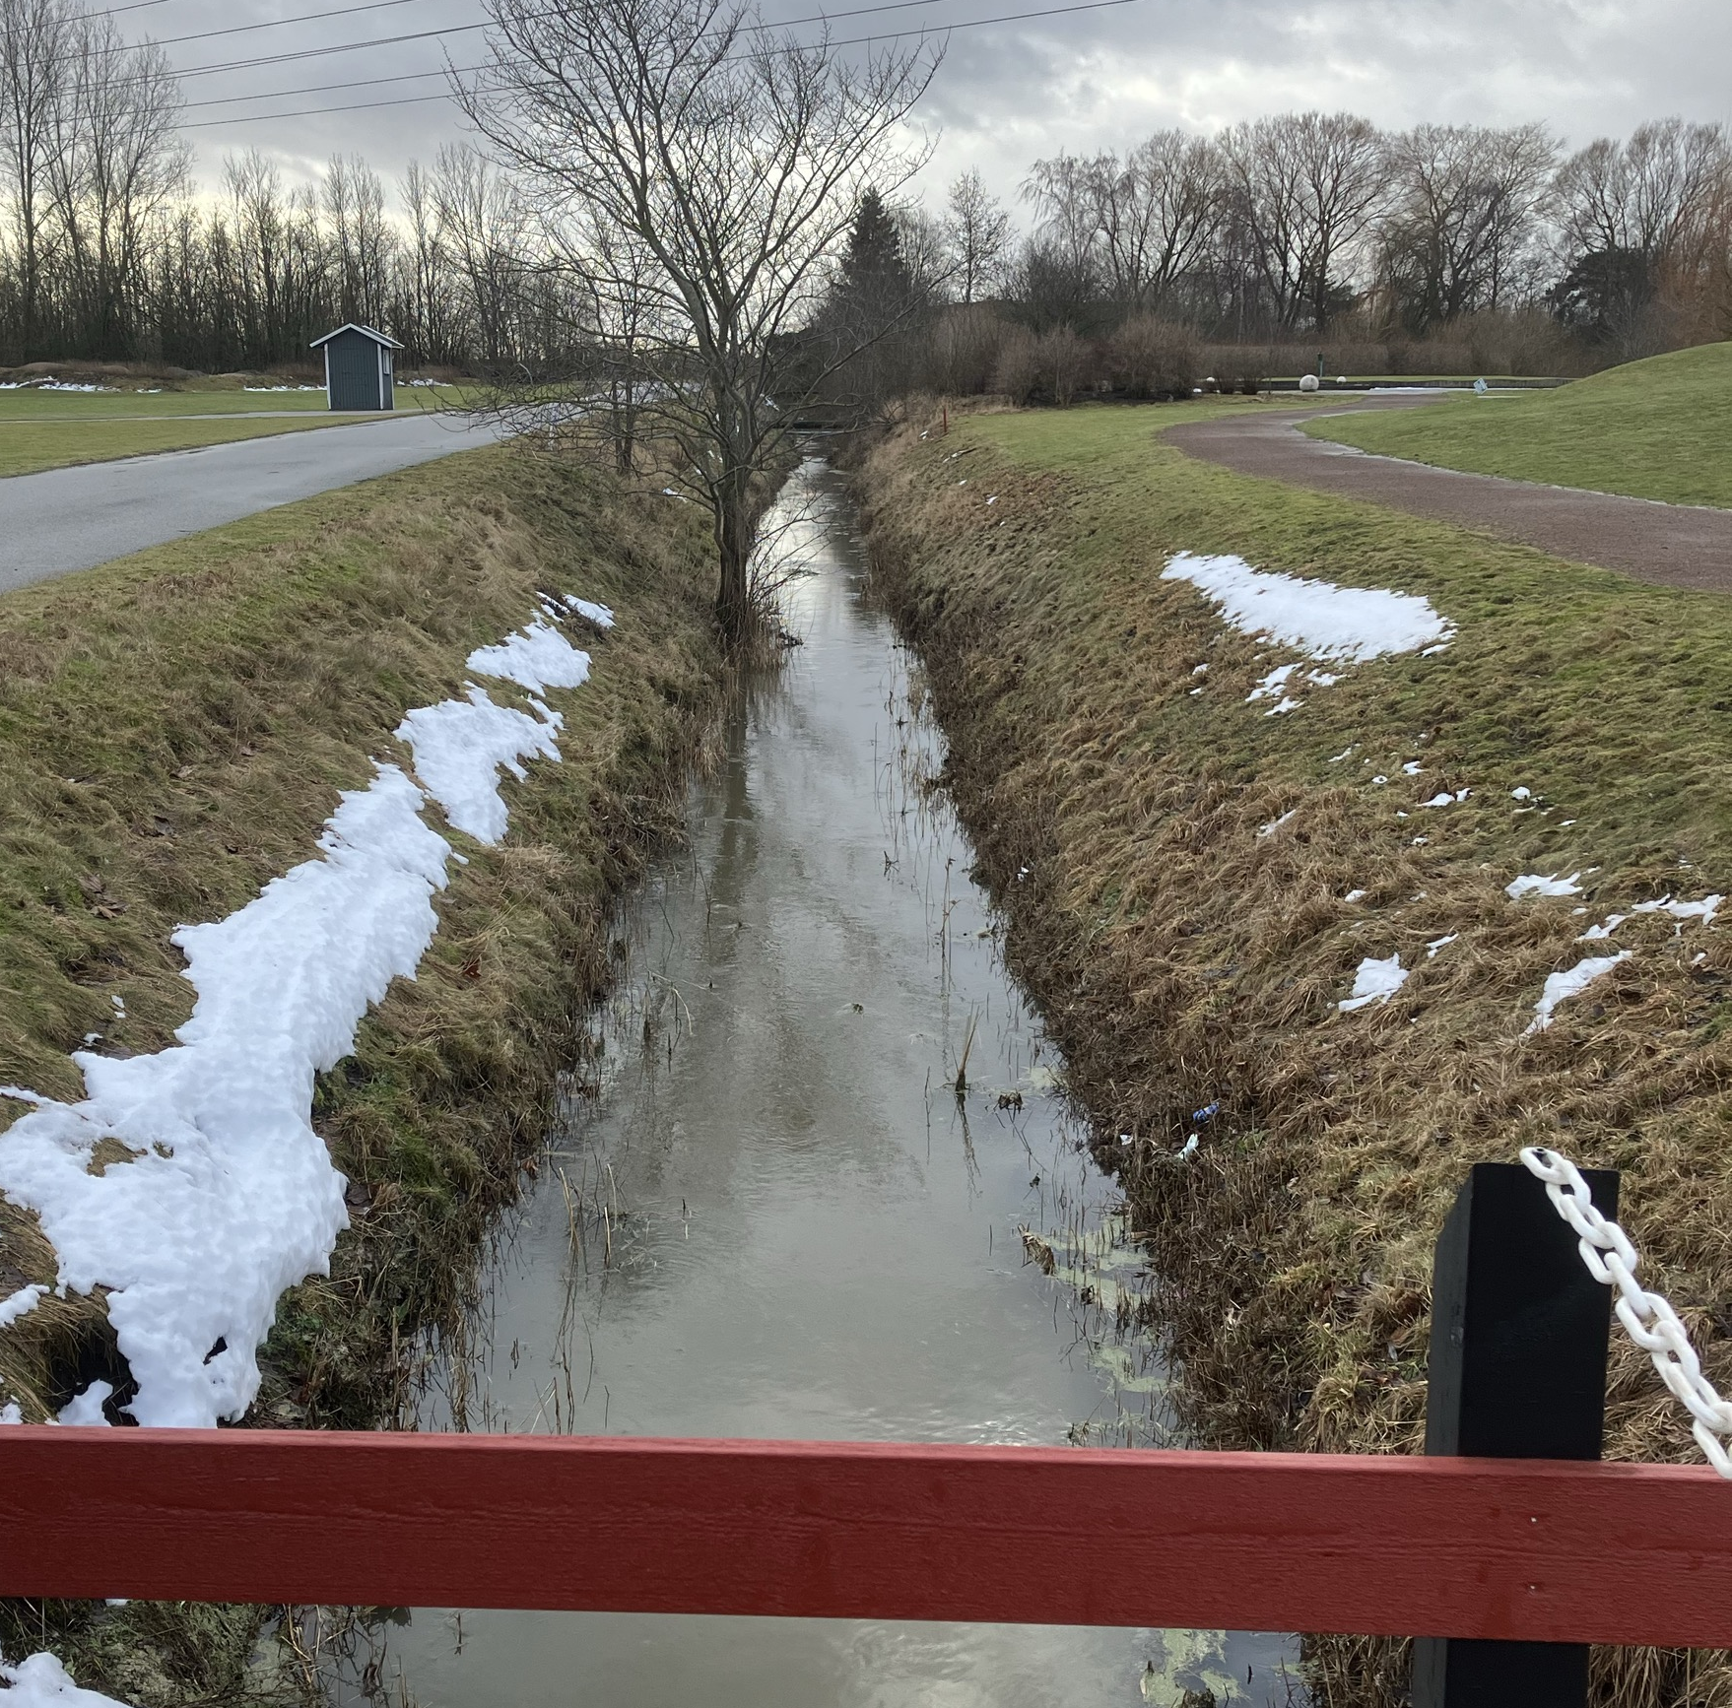
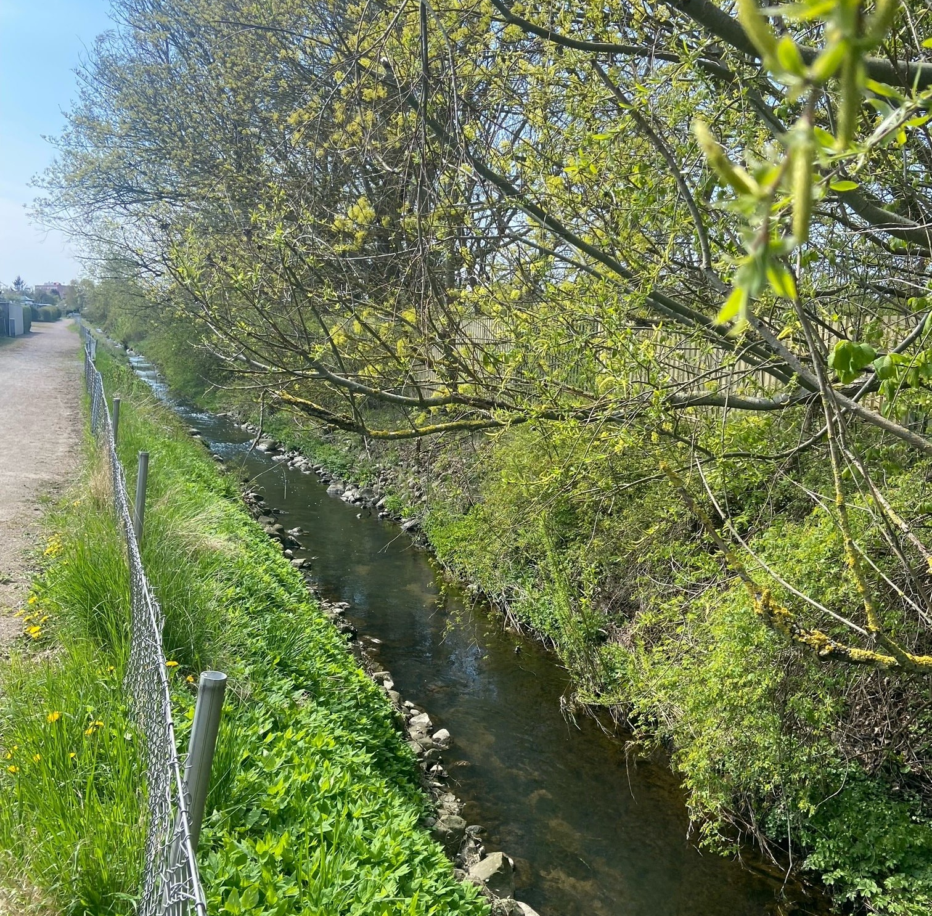
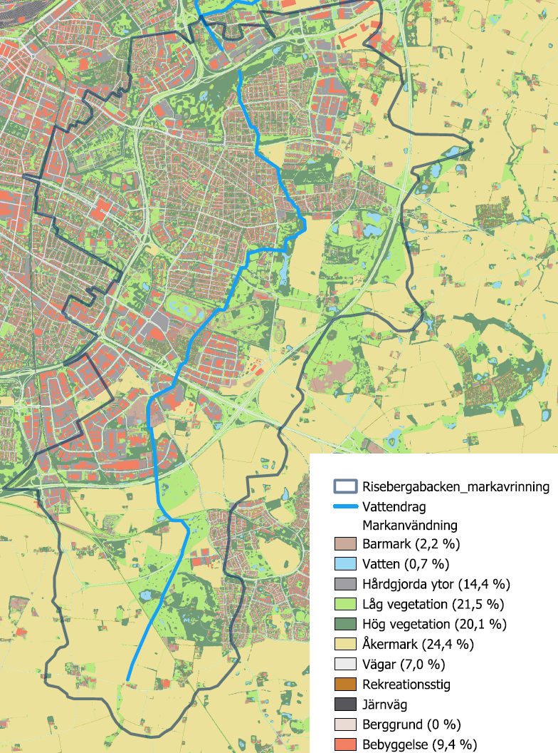
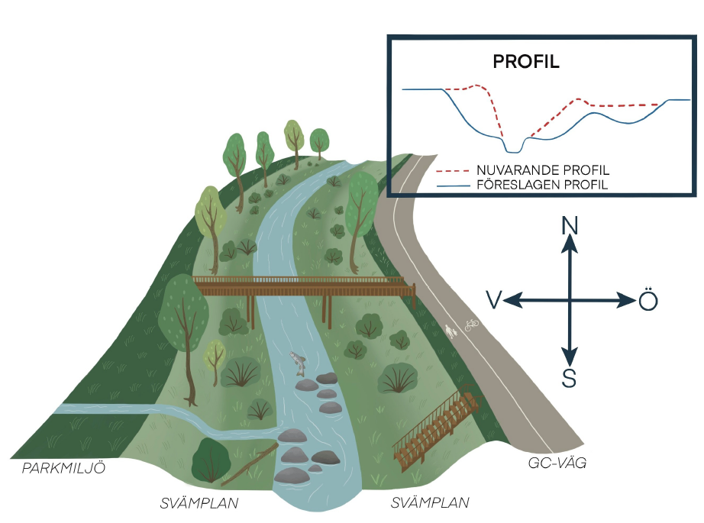
Main objective is to compose a catchment scale development plan that addresses flooding, erosion and water quality.
A small catchment that receives 1/3 of Malmös stormwater
Challenges to:
Get an overview of all relevant activities in the catchment area and have everyone engaged in the same agenda.
Involve stakeholders in an effective and useful context in the general planning phase.
External costs is used for:
Hydraulic modelling
Plan for suggested future NBS for the whole catchment area
Design and preliminary planning for one of the NBS solutions

Slide 3
Main lessons learnt
Involve all relevant departments/experts from the city already in the application process
Have a clear view of where (department, process) the results from the project best belong to ensure future implementation
Integrate and address all challenges within the catchment area to ensure the most effective solutions.
Analyse early on what stakeholders to involve depending on the purpose and the impact and responsibility they have.
What you still don’t know, but would like to ask from other cities with experiences in NBS implementation?
Do they have catchment-based planning documents, what parameters are included in such a document and how is the work organized?

