Slide 1
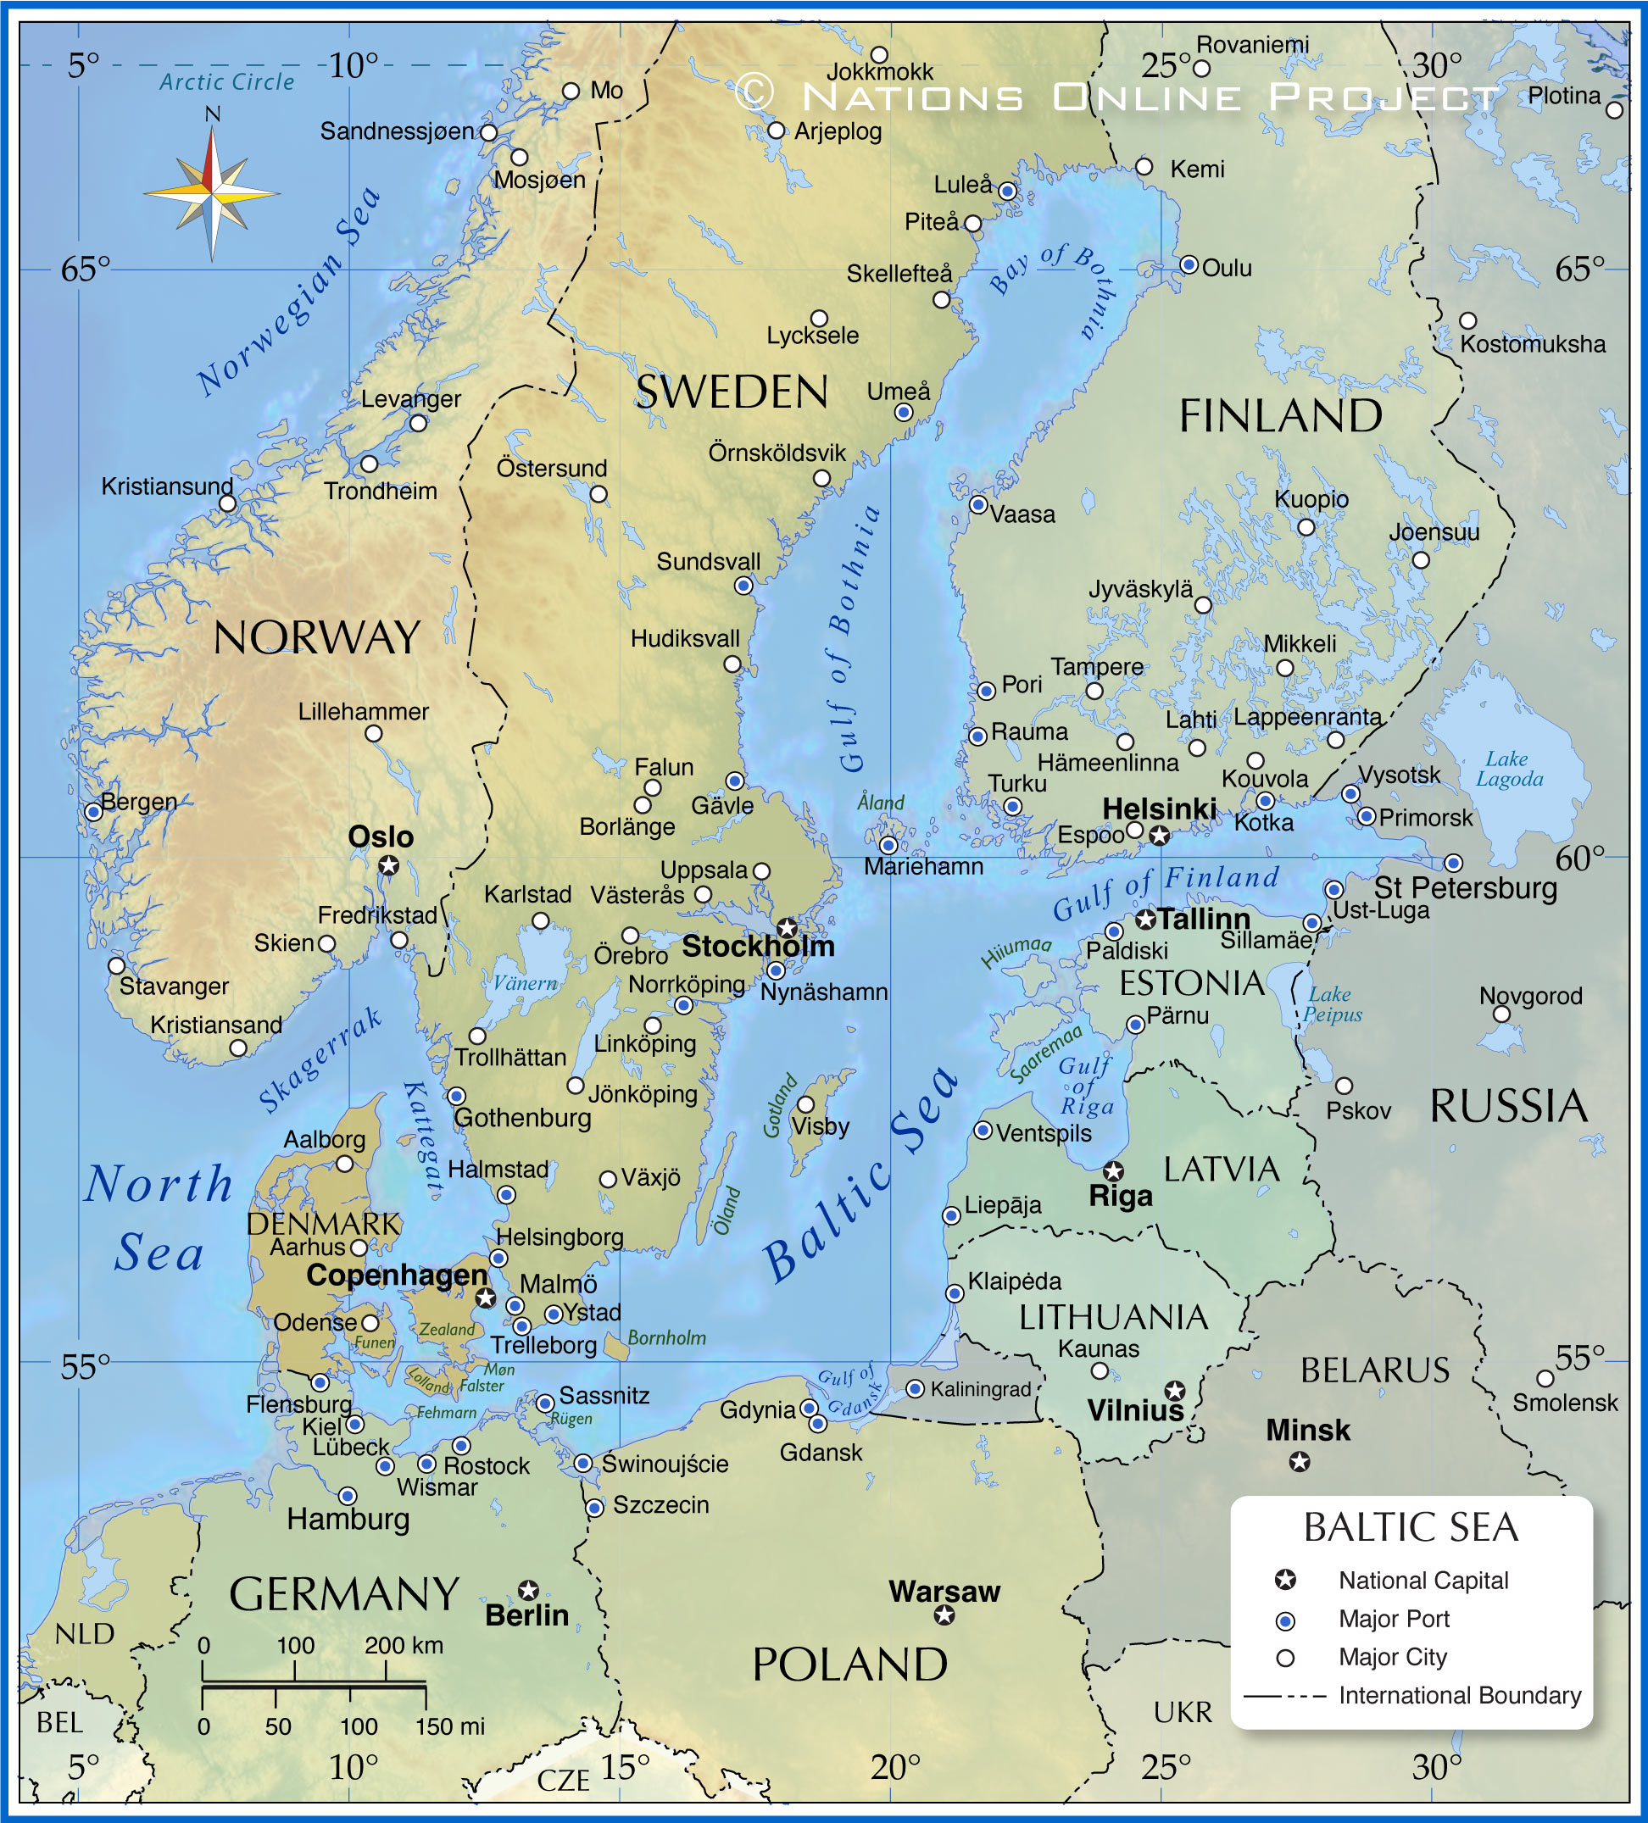

Flood meadows in Varsanpuisto, Tampere
CityBlues meets LATESTadapt

Slide 2
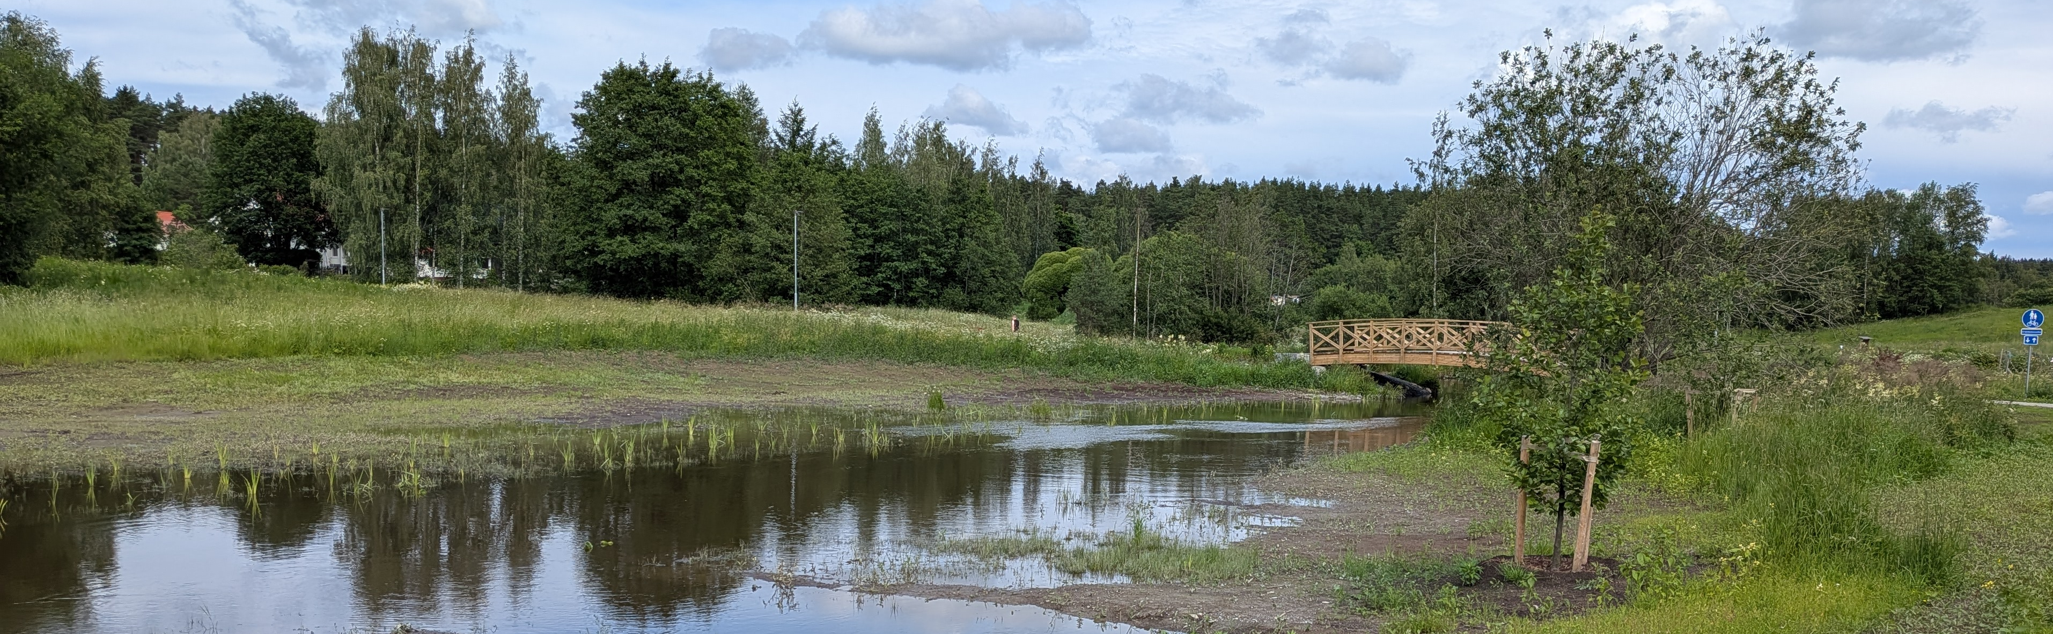

Objectives: Less flooding, increased biodiversity, improved recreational value
Size 8,62 ha
Part of Viinikanoja catchment (size 39,10 km²)
Investment cost 590 000 eur
Designed 2024
Constructed 2025
Main problems: Amount of alien invasive species, rounds of comments and new requirements increased costs

Slide 3
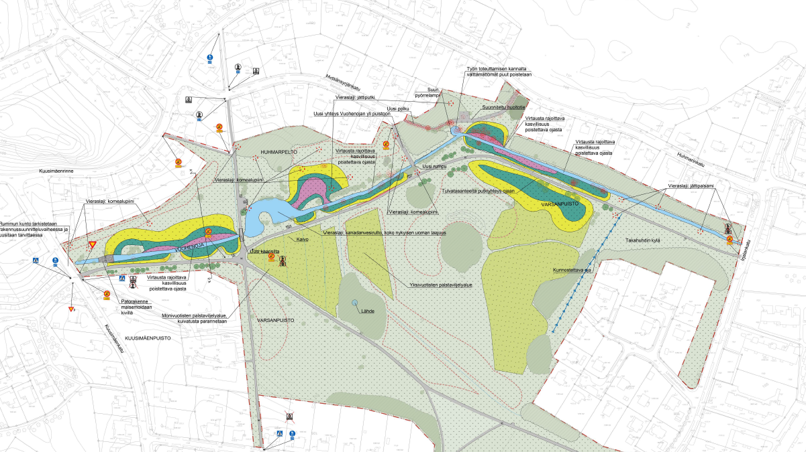
General plan
Circulation pond
Flood meadows
Submerged dam
Notes:
Circulation pond
A kind of sedimentation pond
Retains suspended solids and pollutants
Submerged dam
raises the water level in a controlled manner to the flood meadows

Slide 4
Main lessons learnt
What we would do differently if we would start over?
  Solution: Skip the circulation pond, maybe?
  Planning and design: Book meetings right in the beginning and agree on a commenting schedule in advance.
  In general: Do a comprehensive plan to involve stakeholders.
What you still don’t know, but would like to ask from other cities with experiences in NBS implementation?
  What is the most impactful way to reduce costs when implementing NBS?
  Do you have any experience with how a city could assess the impacts of the NBS on biodiversity?
  Have you got any useful tips how to involve residents in the making of NBS?

