Slide 1
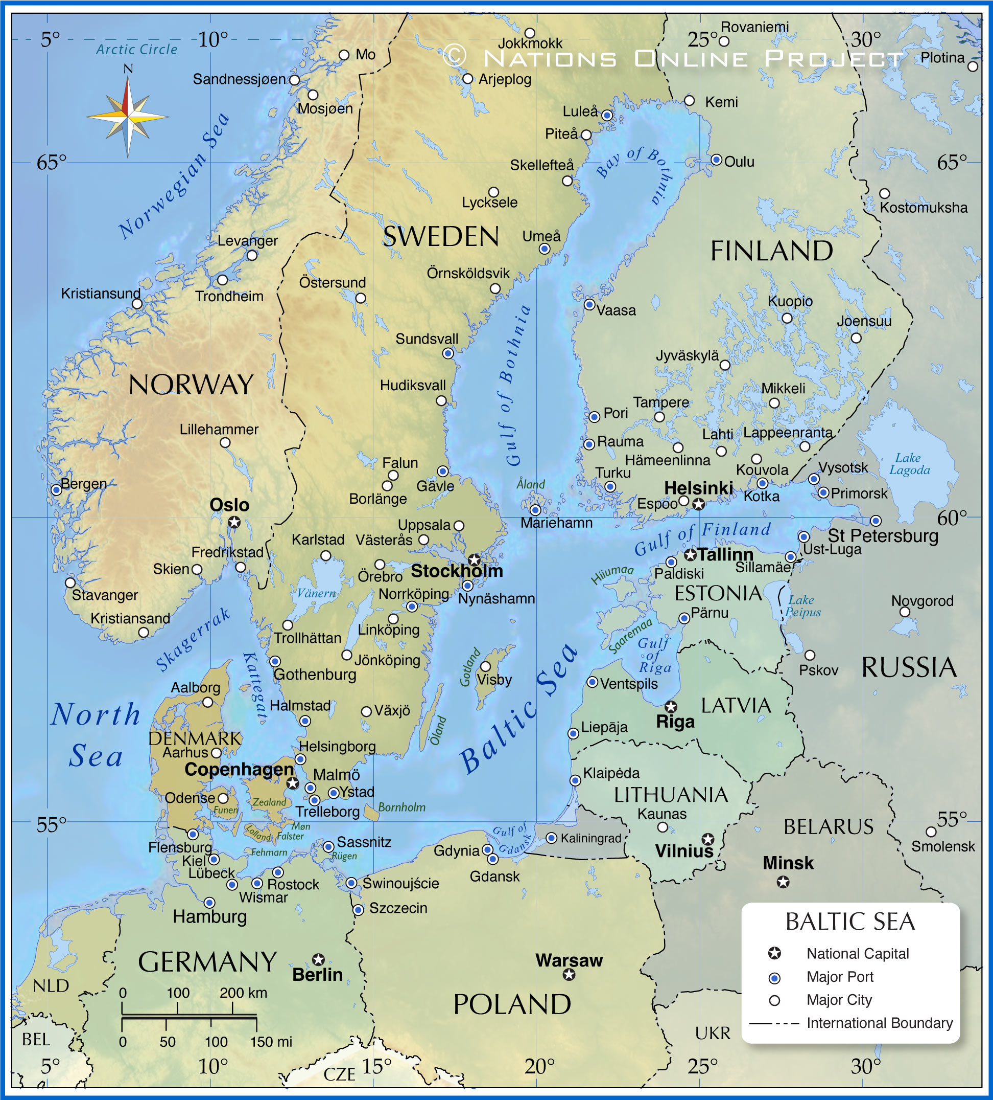

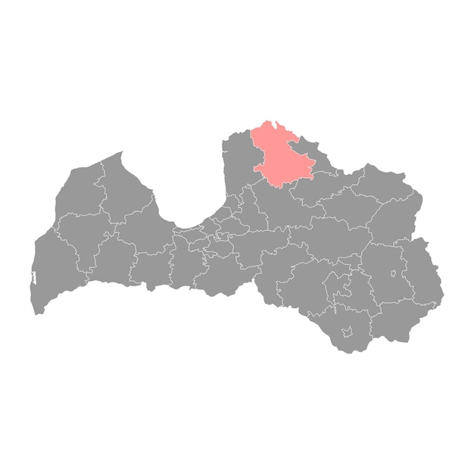


Cēsu Street 4, Valmiera, Latvia
CityBlues meets LATESTadapt
Agnese Vasiļjeva
Landscape architect
Valmiera county municipality
Notes:
Hello,
today I will present our pilot project in Valmiera, located at Cēsu Street 4 in Latvia.

Slide 2
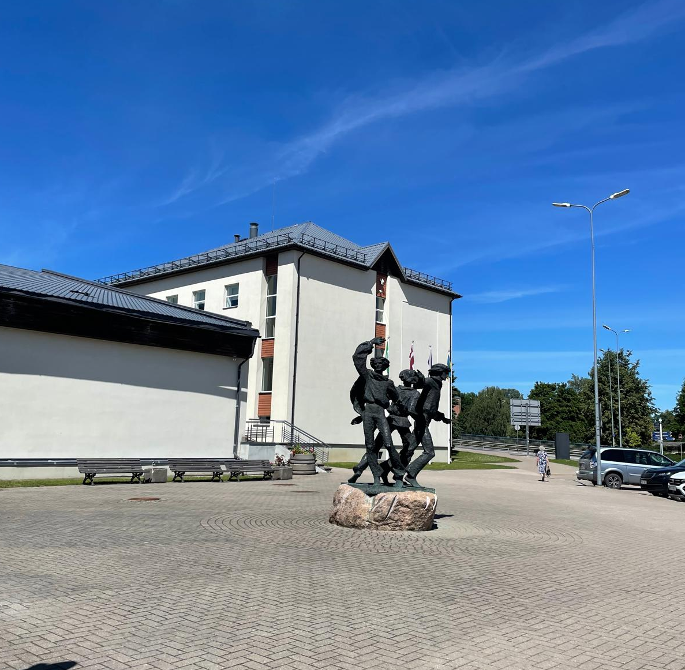
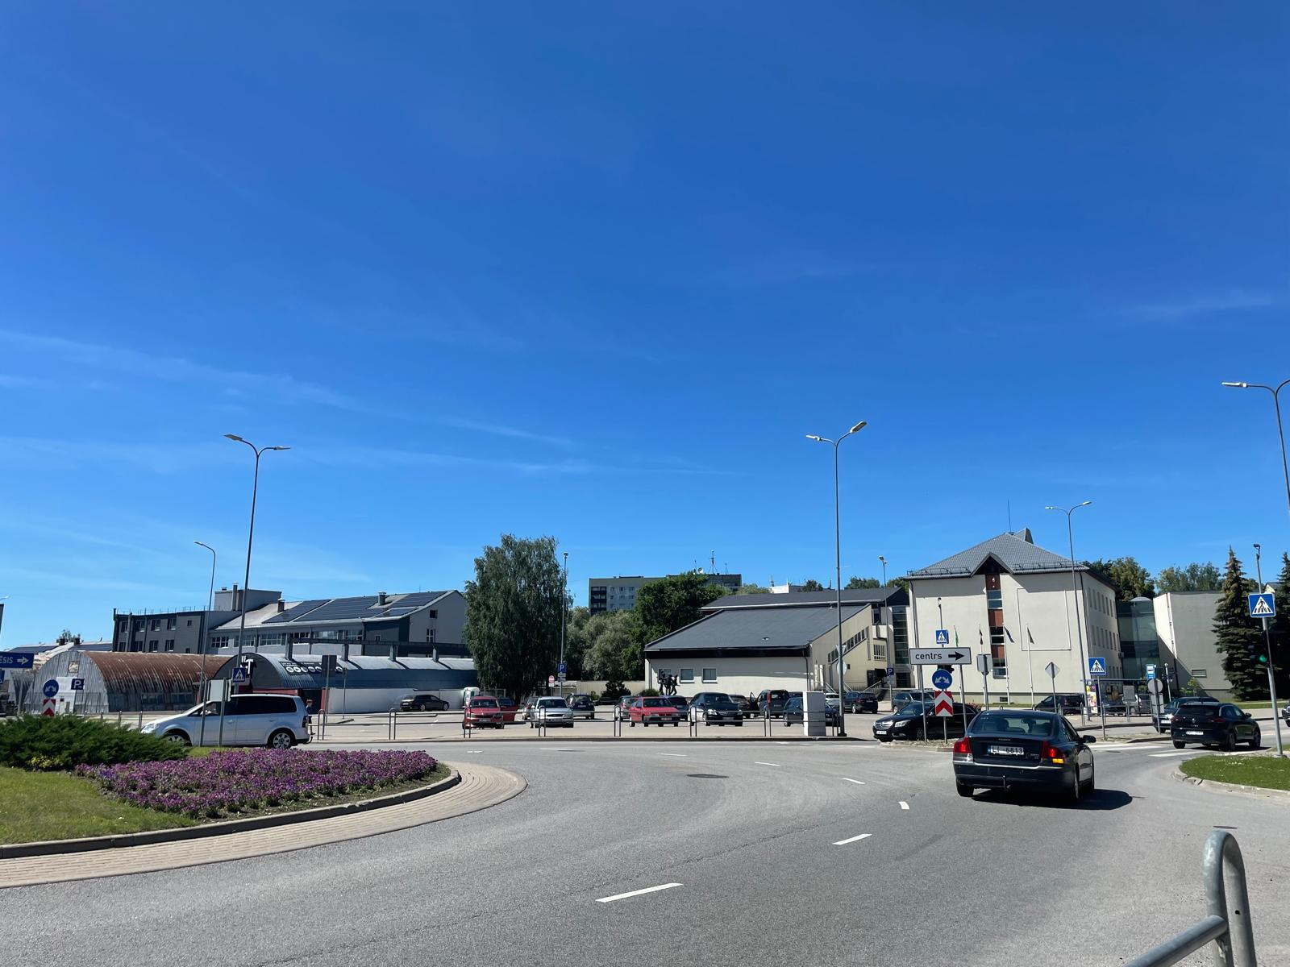
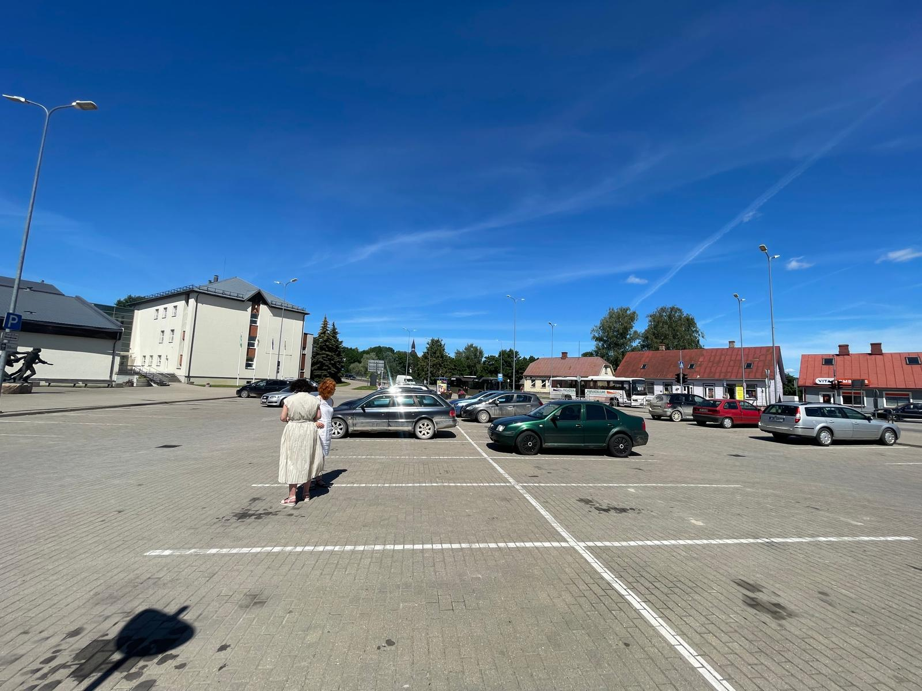
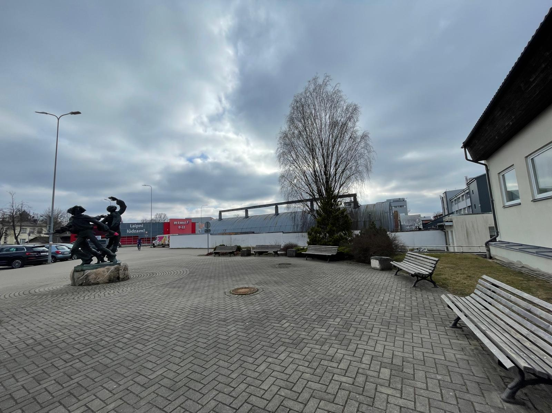
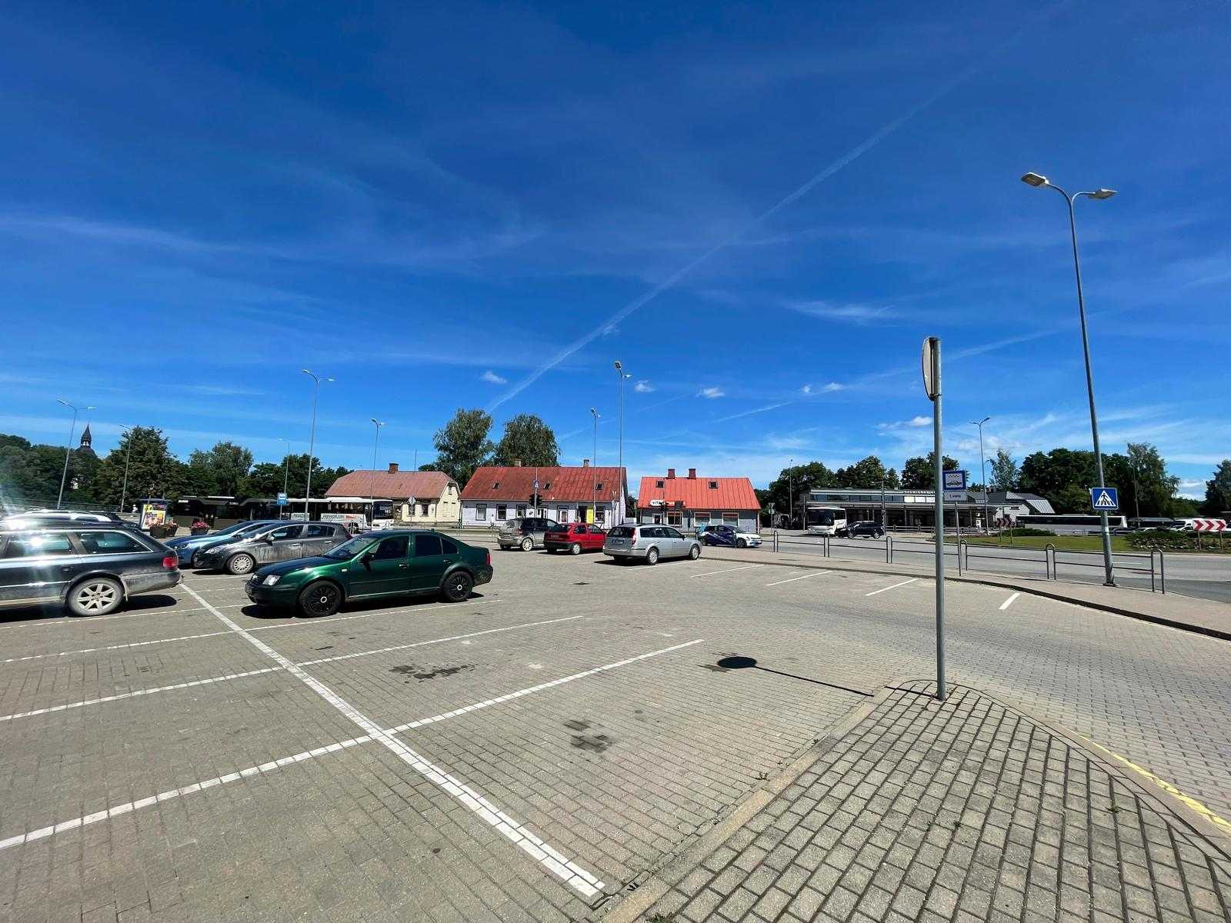
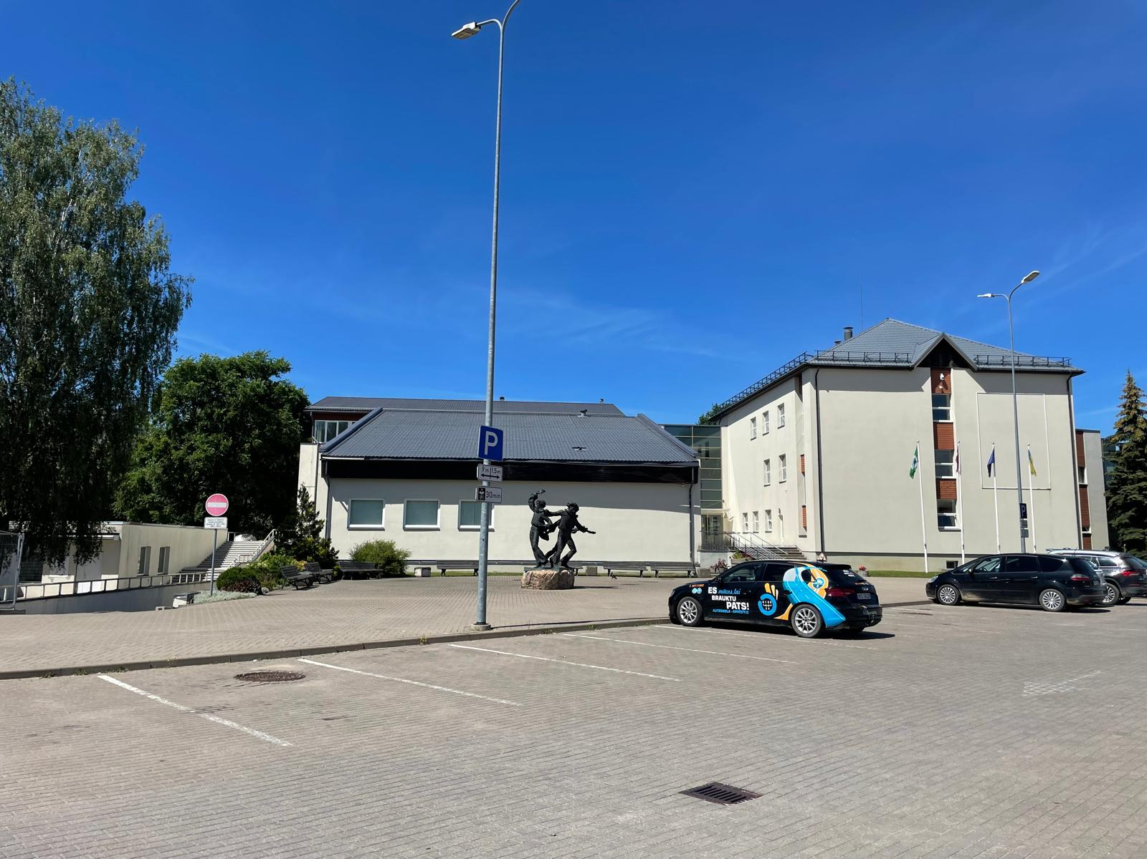
Current situation

Slide 3
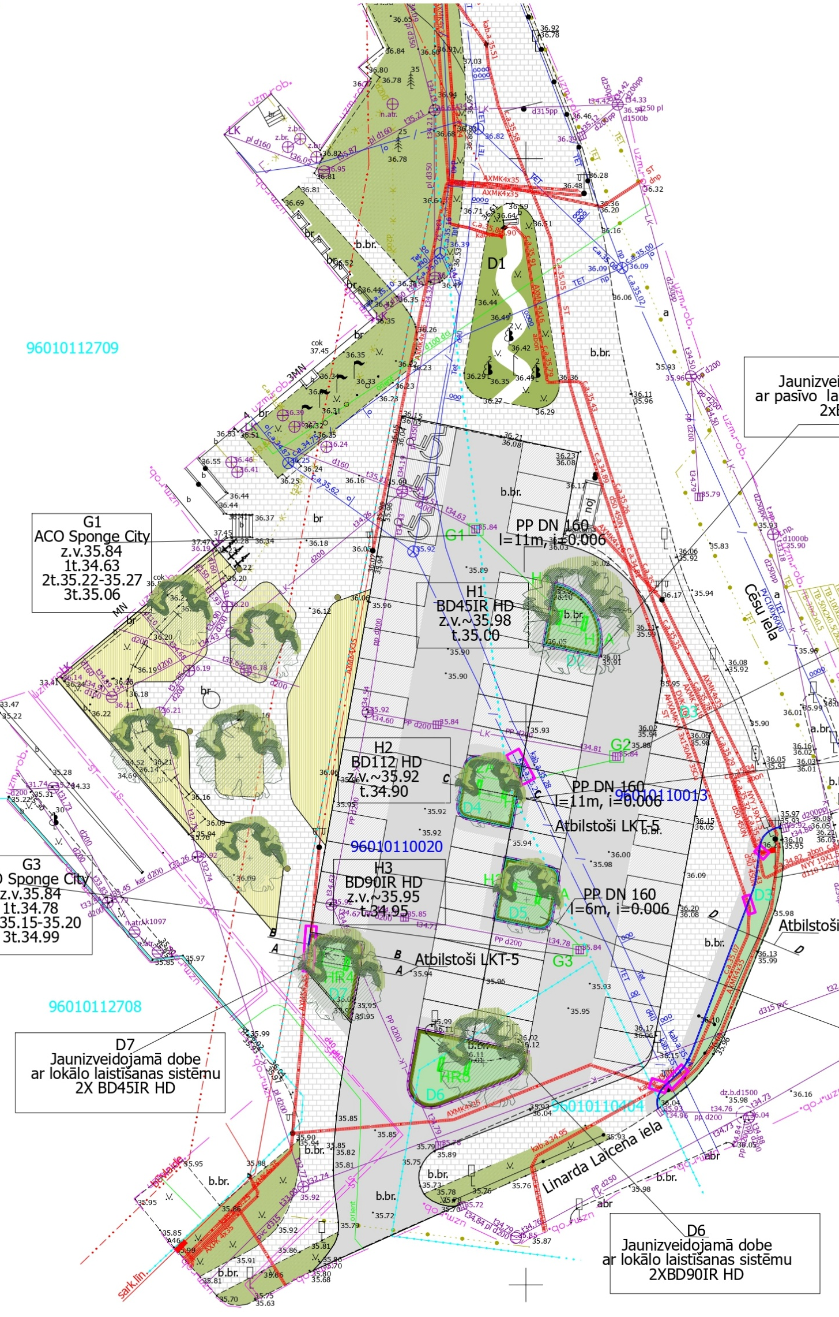
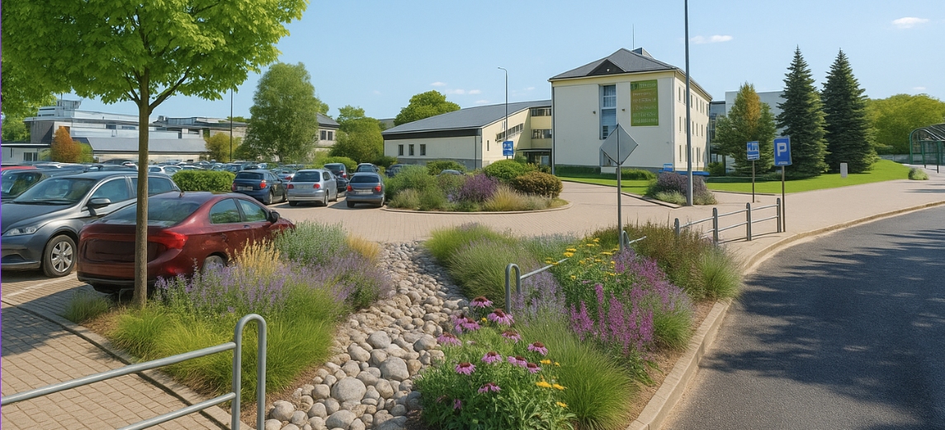
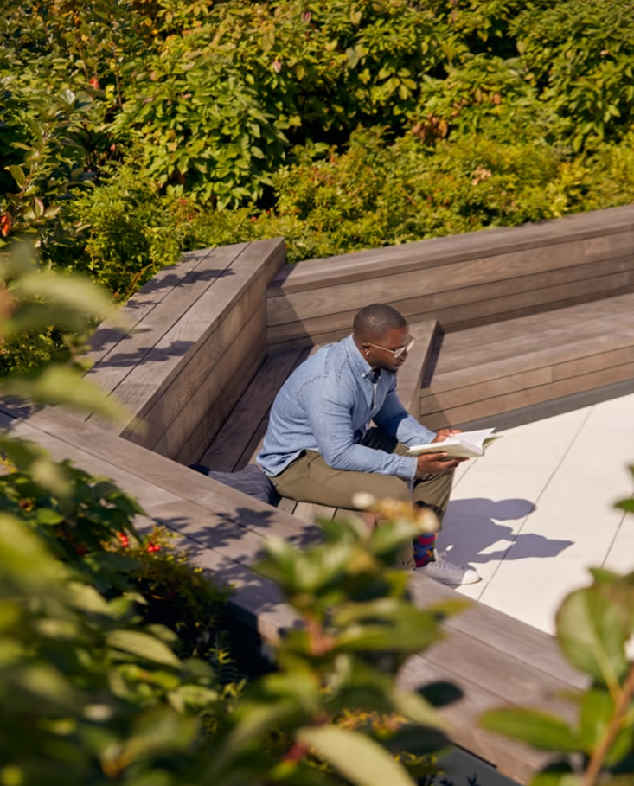
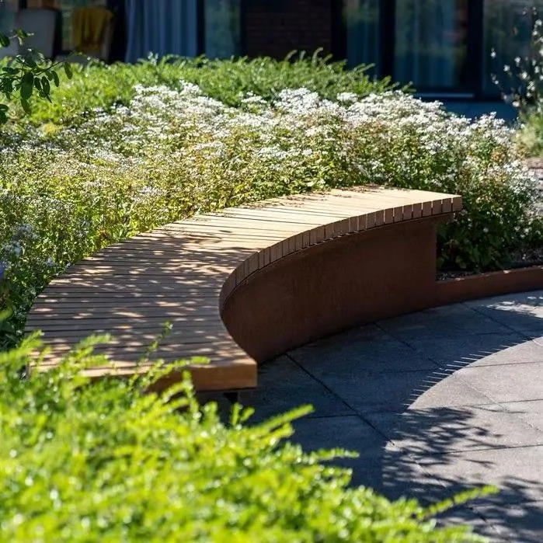
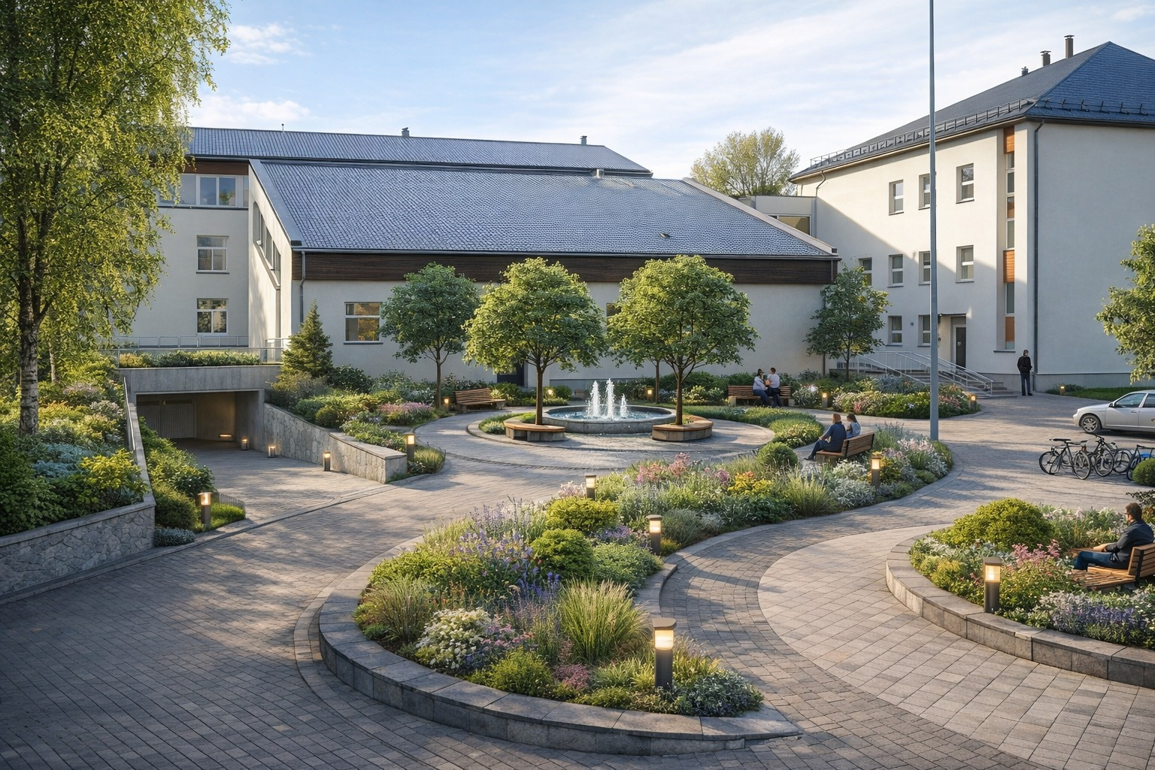
Info:
When designed? – We are still designing
When constructed? – Need to be finished in November
Size – 0.3 (ha)
The aim of the project is to reduce the urban heat island effect by improving the microclimate and promoting the development of green infrastructure. At the same time, the project provides for the efficient collection, storage, and use of rainwater for local needs, particularly for plant irrigation. This approach helps reduce the burden on drainage systems, conserves drinking water, and promotes the sustainable use of resources.
Investments cost (euro) – 150 000 euro (the whole budget)
Notes:
Currently, the project is still in the design phase, and construction is planned to be completed by November. The total project area is about 0.3 hectares, and the overall budget is approximately 150,000 euros.
The main goal of the project is to reduce the urban heat island effect. We want to improve the local microclimate and introduce more green infrastructure into the area. At the same time, we focus on sustainable water management by collecting and reusing rainwater.

Slide 4
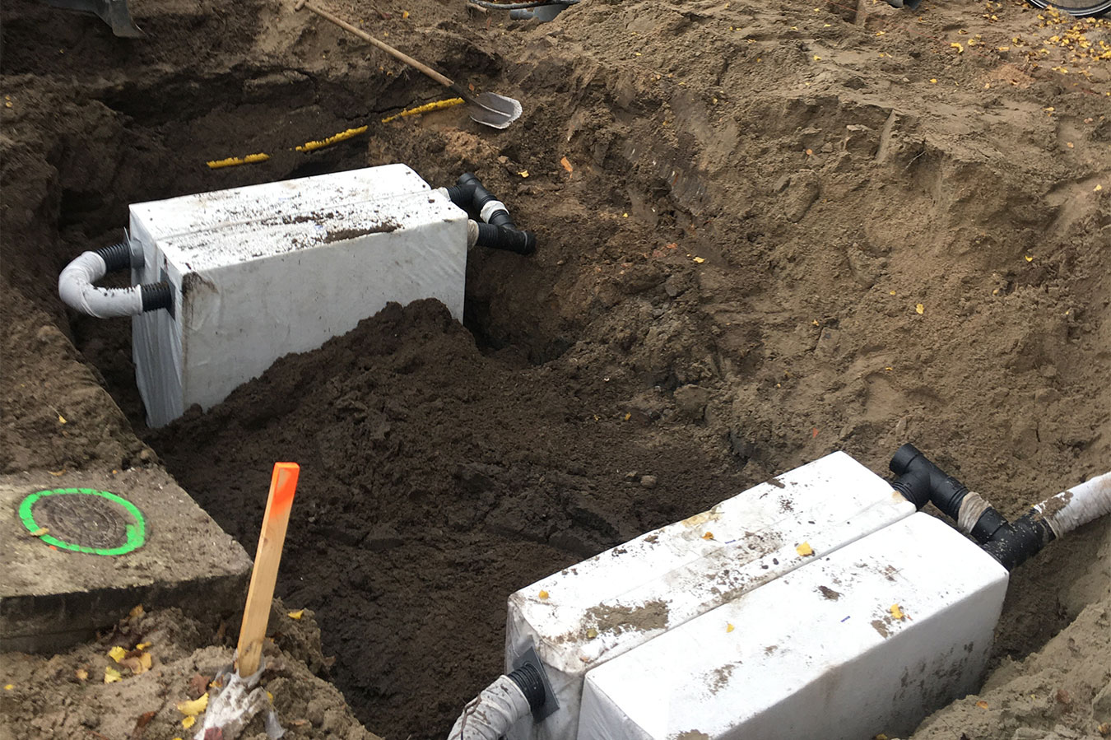
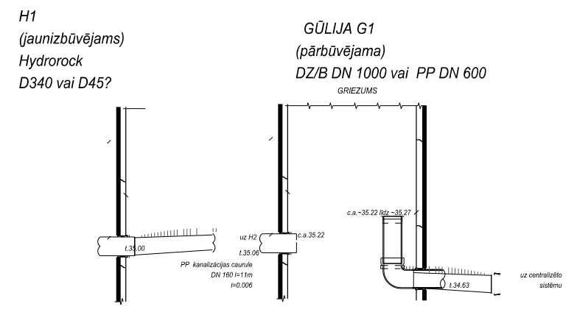
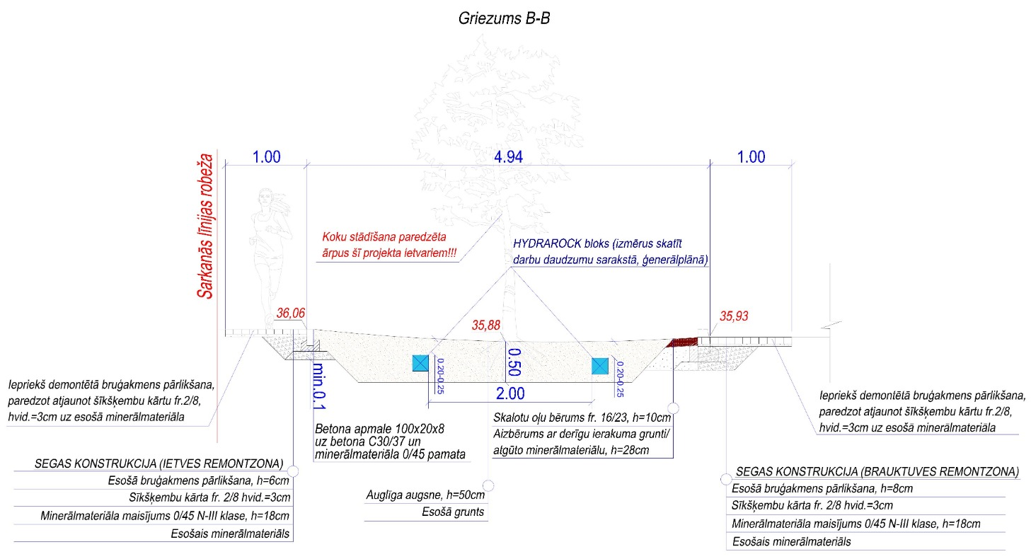
Rainwater collection info:
The project collects rainwater from the existing parking area and the surrounding block, and directs it to newly created green islands. These green areas help improve the local climate and reduce heat. We also plan to use a Hydrorock system to store and use the water for irrigation.
Rainwater will be collected from approximately 500 m² of roof area and 5,000 m² of parking and street surfaces, for a total of 5,500 m² (0.55 hectares).
Notes:
Rainwater will be collected from both roofs and hard surfaces. Specifically, around 500 square meters of roof area and 5,000 square meters of parking and street surfaces. In total, this makes about 5,500 square meters, or 0.55 hectares.
This water will be directed to newly created green islands. These green areas will help cool the environment and improve overall urban conditions.
To manage the water efficiently, we plan to use a Hydrorock system. This system allows us to store rainwater and use it later for plant irrigation. This helps reduce the use of drinking water and decreases pressure on the drainage system.

Slide 5
Main lessons learnt
What we would do differently if we would start over?
Time management;
We wouldn’t develop the construction project ourselves, but would sign a service agreement.
What you still don’t know, but would like to ask from other cities with experiences in NBS implementation?
We would like to ask whether you have used sensors for monitoring in your projects. If yes, what do you measure and what types of sensors do you use?
Would you have any recommendations for our project?
Notes:
During the project development, we have already learned some important lessons. One of the main challenges has been time management. If we started again, we would not develop the construction project ourselves, but instead work with an external service provider.
We are also interested in learning from other cities. For example, we would like to know if you have used sensors in your projects for monitoring. If yes, what do you measure and what types of sensors do you use?
And finally, we would also appreciate any recommendations for improving our project.
Thank you for your attention!

Slide 6
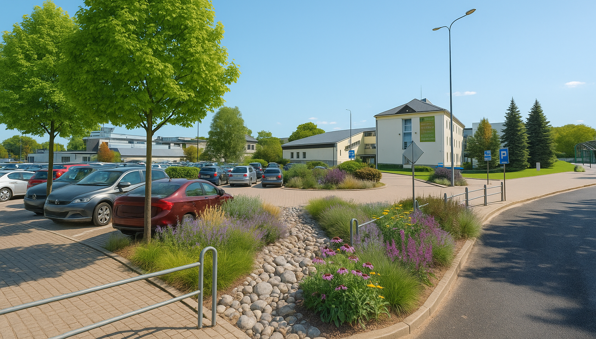
Thank you for your attention!

