Slide 1
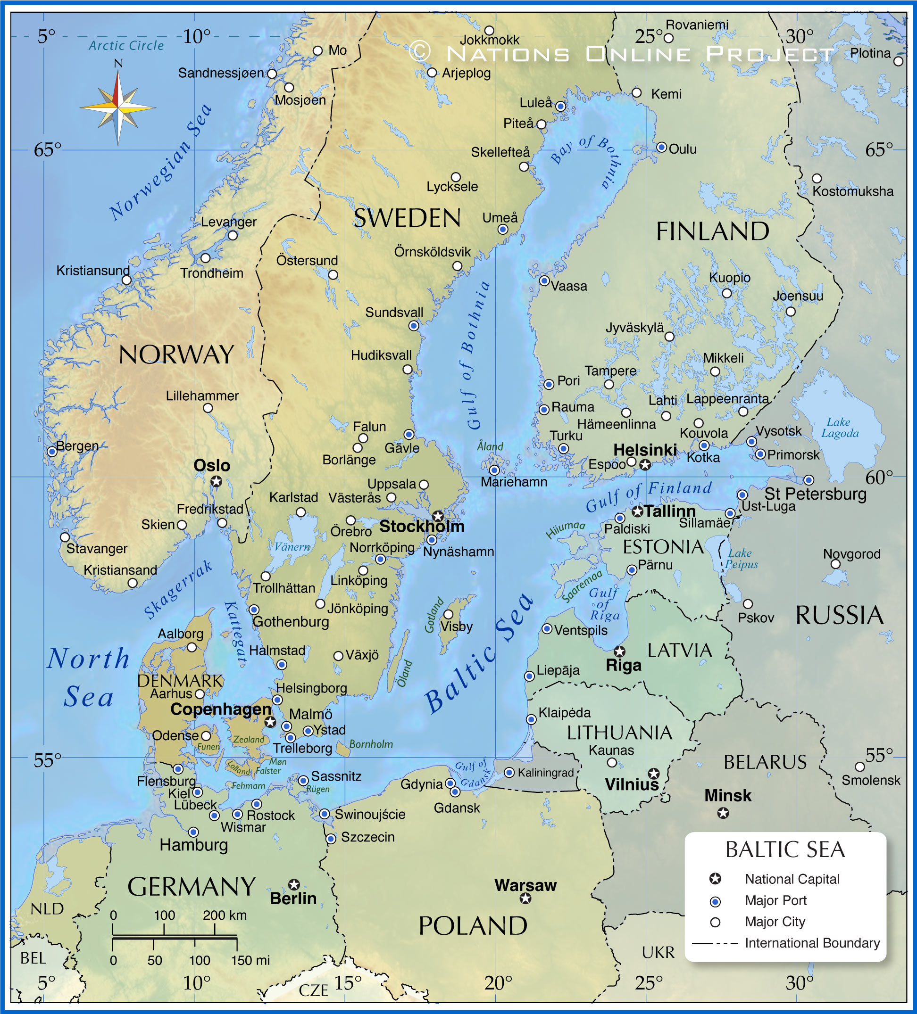



Viimsi Taskupark
CityBlues meets LATESTadapt

Slide 2
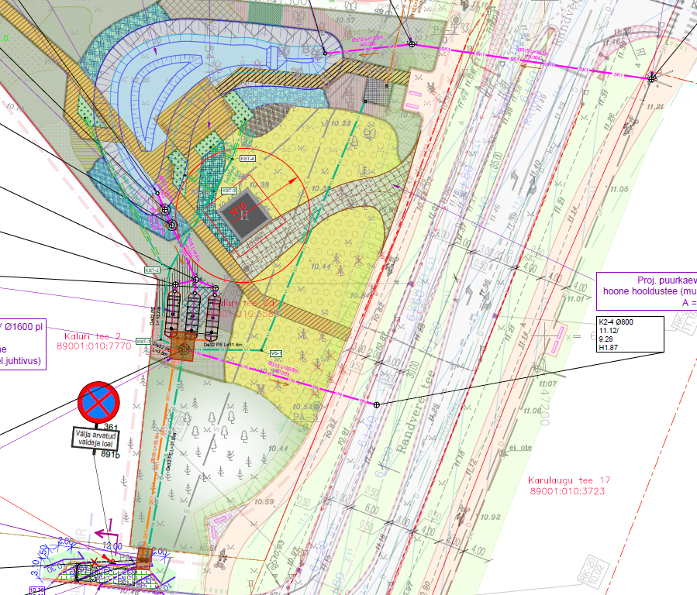
Explain
Objective of the pilot
Size (ha)
Catchment info
List 3 main problems during implementation of the pilot
Cost - 620 306 + (eur)
When designed?
When constructed?
Show the overall schema of the solution

Slide 3
Main lessons learnt
What we would do differently if we would start over?
technical design
budgeting
What you still don’t know, but would like to ask from other cities with experiences in NBS implementation?

